Slide 1
Development of Liability Threshold Model for Family-based Samples and Its Application to Genetic Data
이학박사 학위논문 1차 예비심사 – 2018.6.19
Wonji Kim
Interdisciplinary Program of Bioinformatics Seoul National University

Slide 2
Contents
Introduction
An overview of liability threshold model
Selecting Cases and Controls for GWAS using Family history of Disease
Heritability Estimation and Genetic Association Study in Family-based Design for the Disease on the Binary Trait using Liability Threshold Model
Plan

Slide 3
Introduction
Genome wide association study (GWAS)
Missing heritability
Common disease - Rare variant hypothesis
Extreme phenotype in GWAS
Impact of ascertainment scheme

Slide 4
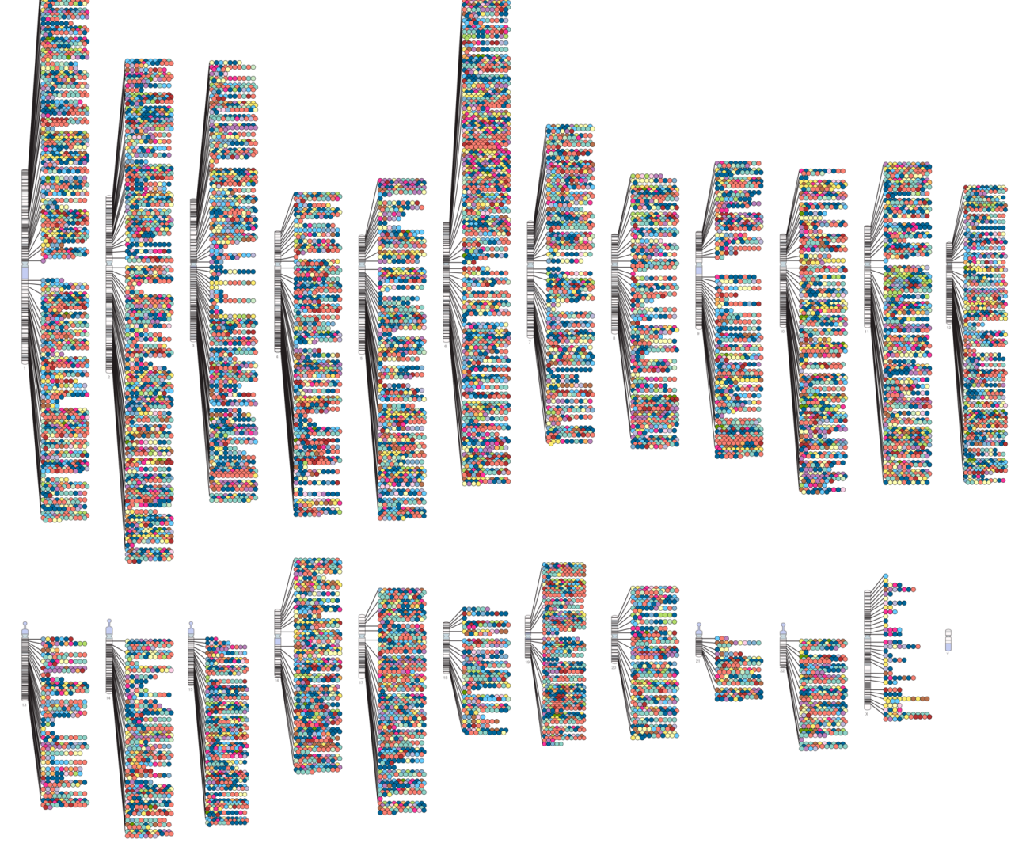
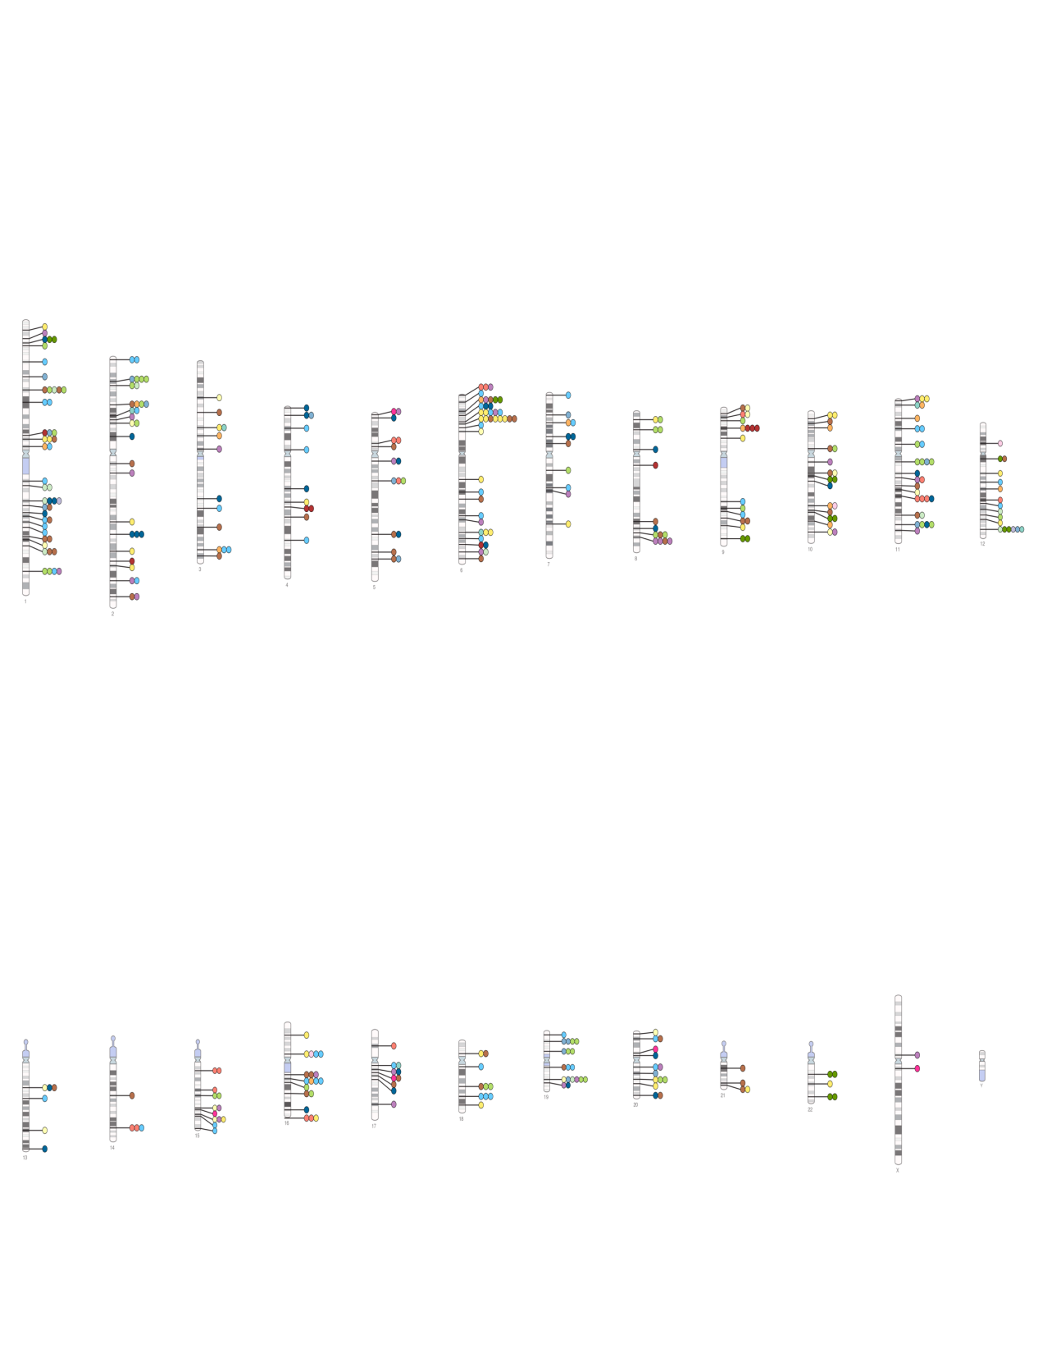
GWAS catalog
1. Introduction
Genome wide association study (GWAS)
Missing heritability
Common disease - Rare variant hypothesis
Associations with p-values less than 5x10⁻⁸ are shown since 2005
~ December. 2008
~ April. 2018
NHGRI GWAS Catalog https://www.ebi.ac.uk/gwas/

Slide 5
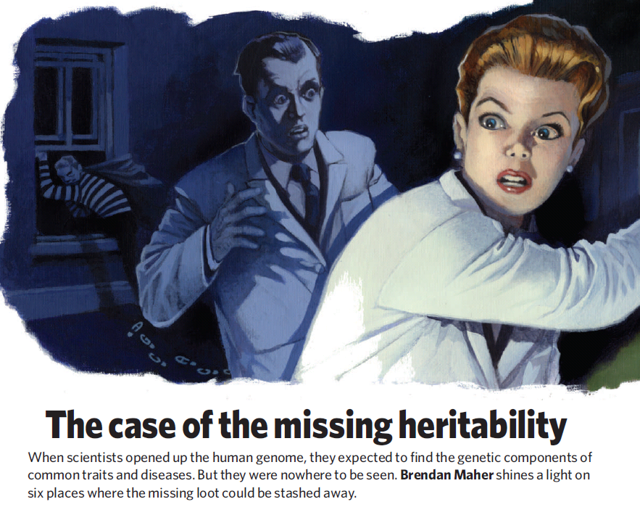
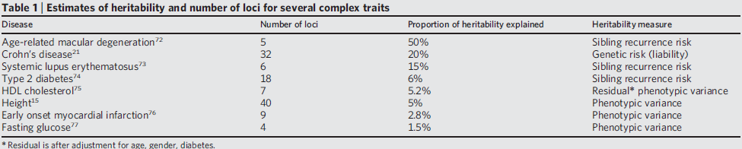
Missing Heritability
1. Introduction
Genome wide association study (GWAS)
Missing heritability
Common disease - Rare variant hypothesis
Possible causes
Rare variants
Epistasis
Gene x Environment interaction
Overestimation of heritability
Manolio et al, Nature 2009

Slide 6
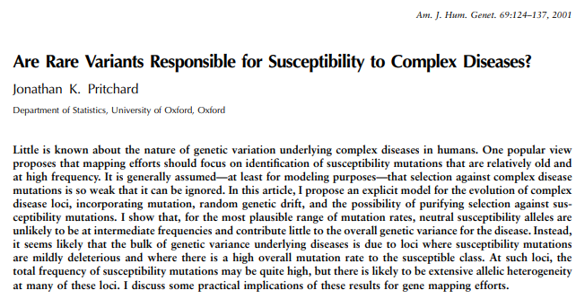
Common disease - Rare variant
1. Introduction
Genome wide association study (GWAS)
Missing heritability
Common disease - Rare variant hypothesis
Multiple rare disease susceptibility loci
Causal variants for each affected subject may be substantially different
Genetic heterogeneity among affected subjects has also complicated genetic association analyses

Slide 7
Extreme Phenotype in GWAS
1. Introduction
Extreme phenotype in GWAS
Impact of ascertainment scheme
Subjects with extreme phenotypes lead to improvement of statistical power in genetic association studies
Author | Journal | Year | Title
Risch and Zhang | American Journal of Human Genetics | 1996 | Mapping quantitative trait loci with extreme discordant sib pairs: sampling considerations
Nebert | European Journal of Pharmacology | 2000 | Extreme discordant phenotype methodology: an intuitive approach to clinical pharmacogenetics
Perez-Gracia and Ruiz-Ilundain et al. | CANCER-PHILADELPHIA | 2002 | The role of extreme phenotype selection studies in the identification of clinically relevant genotypes in cancer research
Guey and Kravic et al. | Genetic Epidemiology | 2011 | Power in the phenotypic extremes: a simulation study of power in discovery and replication of rare variants
Li and Lewinger et al. | Genetic Epidemiology | 2011 | Using extreme phenotype sampling to identify the rare causal variants of quantitative traits in association studies
Barnett and Lee et al. | Genetic Epidemiology | 2013 | Detecting rare variant effects using extreme phenotype sampling in sequencing association studies

Slide 8
Impact of Ascertainment Scheme
1. Introduction
Extreme phenotype in GWAS
Impact of ascertainment scheme
In previous studies, subjects with many affected relatives tend to contain more disease genotypes for heritable disease, and it have often led to additional improvements in statistical power
Or Heuristic method such as the number of affected first-degree relatives
Author | Year | Contents
Risch and Teng | 1998 | Single-locus genetic model. Affected individuals with at least one affected sibling carry more copies of the disease allele.
Fingerlin et al | 2004 | Considered independent cases with at least one affected sibling who shows the most evidence of IBD allele sharing.
Risch | 2001 | Multi-locus genetic model. (Single major locus with a polygenic background) They compared disease allele frequencies for MZ and DZ twins VS that in singletons.
Joanna et al | 2005 | Generalization of Risch (2001)

Slide 9
Limitations of Previous Approaches
1. Introduction
Extreme phenotype in GWAS
Impact of ascertainment scheme
Limited family structure
Only sibling, twin data or only first-degree relatives
Not applicable for complicated situation
Subjects with three affected and one unaffected grandparent VS those with a single affected parent

Slide 10
An Overview of Liability Threshold Model
Review of Liability Threshold Model
Review of heritability
Purpose and novelty of this study

Slide 11
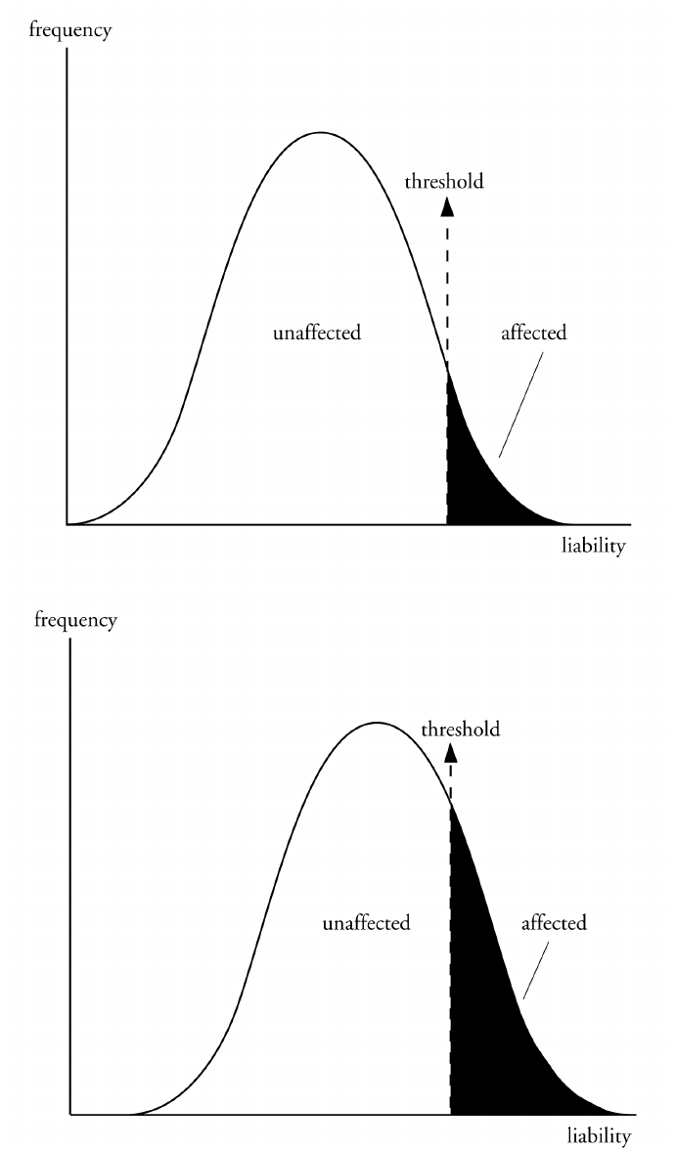
Liability Threshold Model (LTM)
2. An overview of liability threshold model
Review of Liability Threshold Model
Review of heritability
Purpose and novelty of this study
Liability is a term used to describe all the genetic and environmental factors that contribute to the development of a multifactorial disorder.
A lot of multifactorial traits display continuous variation such as height and intelligence.
However, some multifactorial disorders such as diabetes mellitus and cancer display discontinuous variation with individuals either being affected or not.
The threshold model allows this phenomenon to be explained.

Slide 12
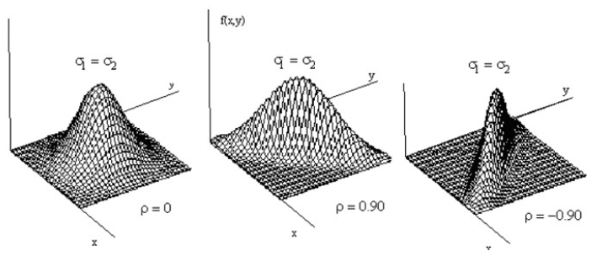
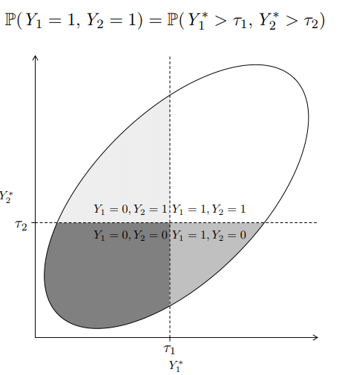
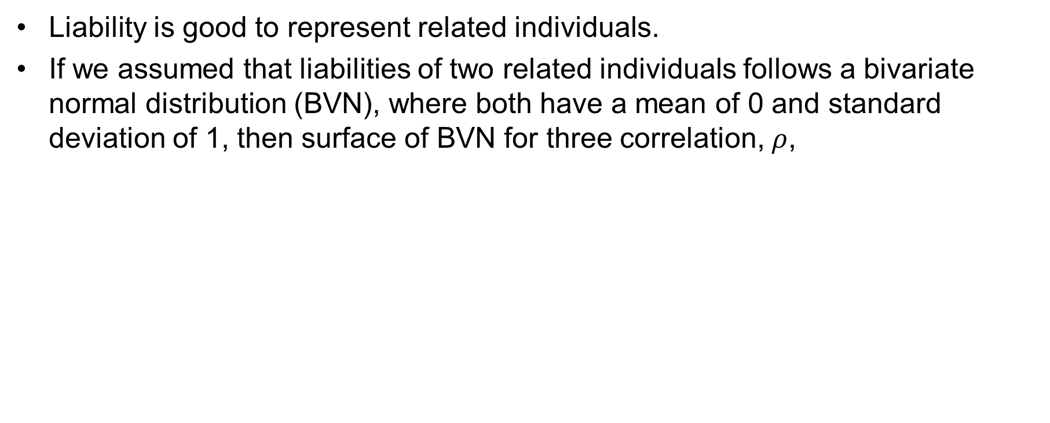
Liability Threshold Model (LTM)
2. An overview of liability threshold model
Review of Liability Threshold Model
Review of heritability
Purpose and novelty of this study
Liability is good to represent related individuals.
If we assumed that liabilities of two related individuals follows a bivariate normal distribution (BVN), where both have a mean of 0 and standard deviation of 1, then surface of BVN for three correlation, $ρ$,

Slide 13
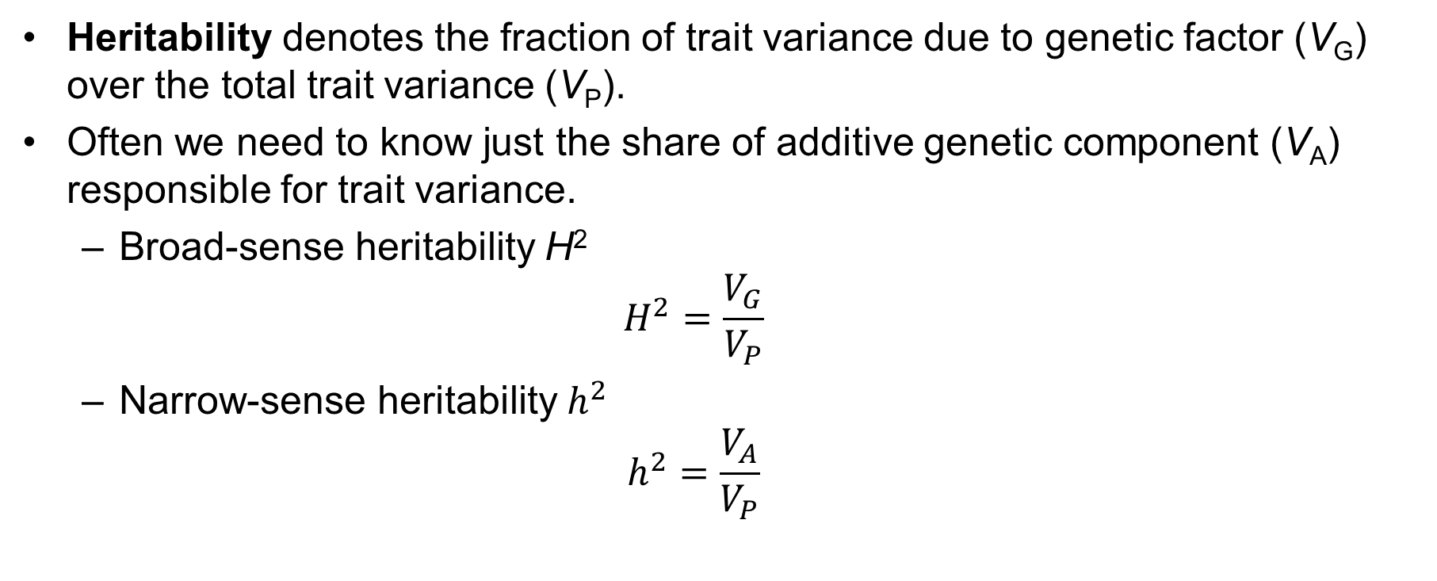
Heritability
2. An overview of liability threshold model
Review of Liability Threshold Model
Review of heritability
Purpose and novelty of this study
Heritability denotes the fraction of trait variance due to genetic factor (V_{G}) over the total trait variance (V_{P}).
Often we need to know just the share of additive genetic component (V_{A}) responsible for trait variance.
Broad-sense heritability H²
$$H^{2}=\frac{V_{G}}{V_{P}}$$
Narrow-sense heritability $h^{2}$
$$h^{2}=\frac{V_{A}}{V_{P}}$$

Slide 14
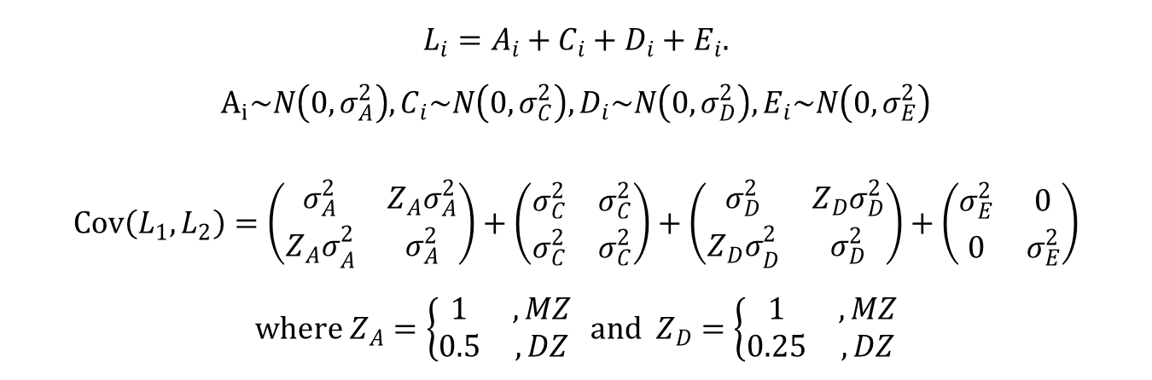
Heritability in Liability Threshold Model
2. An overview of liability threshold model
Review of Liability Threshold Model
Review of heritability
Purpose and novelty of this study
Polygenic model for bivariate liabilities of twin (ACE model)
$$L_{i}=A_{i}+C_{i}+D_{i}+E_{i}.$$
$$A_{i}\sim N\left(0,σ_{A}^{2}\right), C_{i}\sim N\left(0,σ_{C}^{2}\right), D_{i}\sim N\left(0,σ_{D}^{2}\right), E_{i}\sim N\left(0,σ_{E}^{2}\right)$$
$$Cov\left(L_{1},L_{2}\right)=\left(\begin{matrix}σ_{A}^{2} & Z_{A}σ_{A}^{2} \\ {Z_{A}σ}_{A}^{2} & σ_{A}^{2}\end{matrix}\right)+\left(\begin{matrix}σ_{C}^{2} & σ_{C}^{2} \\ σ_{C}^{2} & σ_{C}^{2}\end{matrix}\right)+\left(\begin{matrix}σ_{D}^{2} & Z_{D}σ_{D}^{2} \\ {Z_{D}σ}_{D}^{2} & σ_{D}^{2}\end{matrix}\right)+\left(\begin{matrix}σ_{E}^{2} & 0 \\ 0 & σ_{E}^{2}\end{matrix}\right)$$
$$where Z_{A}=\left\{\begin{matrix}1 & , MZ \\ 0.5 & , DZ\end{matrix}\right. and Z_{D}=\left\{\begin{matrix}1 & , MZ \\ 0.25 & , DZ\end{matrix}\right.$$
Neale, M. C. C. L., & Cardon, L. R. (2013). Methodology for genetic studies of twins and families (Vol. 67). Springer Science & Business Media

Slide 15
Recent Improvements
2. An overview of liability threshold model
Review of Liability Threshold Model
Review of heritability
Purpose and novelty of this study
Estimation of heritability on binary traits
Method | Contents
Twin Method | Resemblance between MZ twins VS DZ twins
Falconer’s method | Liability threshold model
ACE model | Liability threshold model for twins
Mixed Linear Models | Beta-binomial method, Logistic regression with random effect

Slide 16
Limitations of Previous Approaches
2. An overview of liability threshold model
Review of Liability Threshold Model
Review of heritability
Purpose and novelty of this study
Restricted family structure
Twin Method
ACE model
Beta-binomial method
Falconer’s method
Estimating effect of covariate
Falconer’s method
Estimating variance components (not heritability)
Logistic regression with random effect

Slide 17
Purpose and Novelty of This Study
2. An overview of liability threshold model
Review of Liability Threshold Model
Review of heritability
Purpose and novelty of this study
In chapter 3, the proposed method could
quantify family history of disease for general family structure
select informative subjects based on the disease status of their relatives
improve statistical power of genetic association studies
be implemented with R language
In chapter 4, the proposed method could
estimate the heritability and genetic/environmental effect simultaneously
provide robust estimator to misspecification of prevalence
perform statistical testing using conditional expected score test

Slide 18
Selecting Cases and Controls for GWAS using Family history of Disease
Notations and the disease model
Selection of samples with extreme phenotypes
Simulation study
Application to GWAS of T2D
Discussion

Slide 19
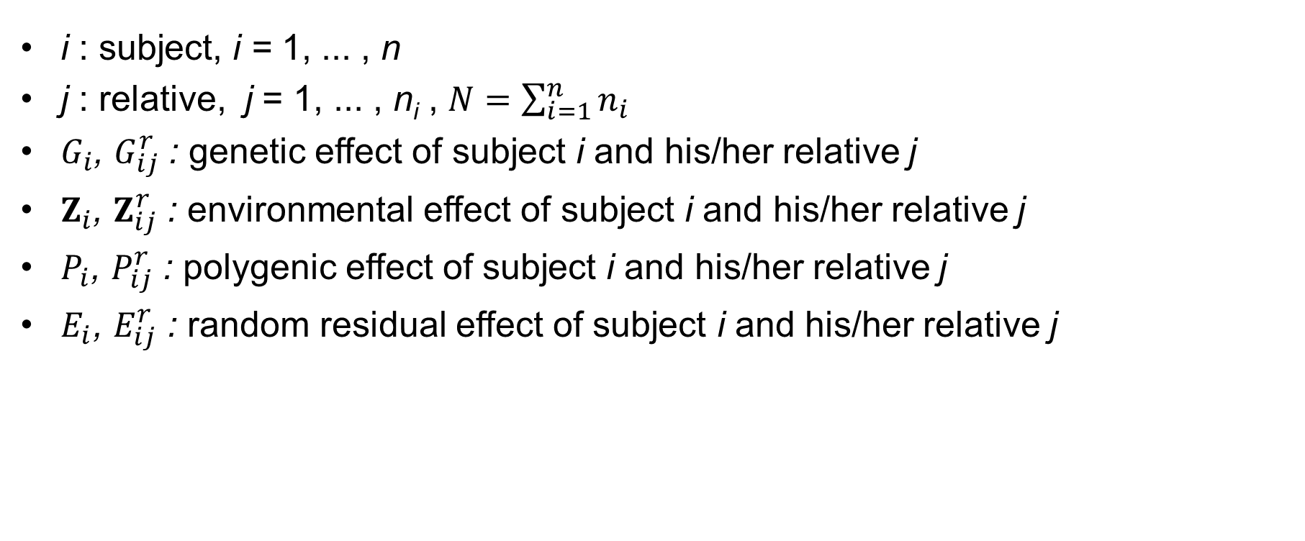
Notations
3. Selecting Cases and Controls for GWAS using Family history of Disease
Notations and the disease model
Selection of samples with extreme phenotypes
Statistical power when the family history of disease is controlled
i : subject, i = 1, ... , n
j : relative, j = 1, ... , n_{i} , $N=\sum_{i=1}^{n}{n_{i}}$
$G_{i}$, $G_{ij}^{r}$ : genetic effect of subject i and his/her relative j
$Z_{i}$, $Z_{ij}^{r}$ : environmental effect of subject i and his/her relative j
$P_{i}$, $P_{ij}^{r}$ : polygenic effect of subject i and his/her relative j
$E_{i}$, $E_{ij}^{r}$ : random residual effect of subject i and his/her relative j

Slide 20
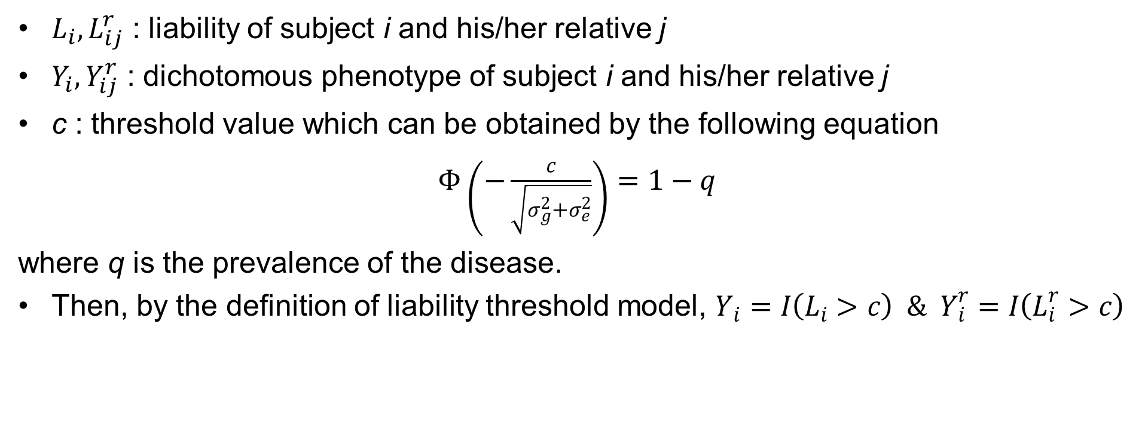
Notations
3. Selecting Cases and Controls for GWAS using Family history of Disease
Notations and the disease model
Selection of samples with extreme phenotypes
Statistical power when the family history of disease is controlled
$L_{i}, L_{ij}^{r}$ : liability of subject i and his/her relative j
$Y_{i}, Y_{ij}^{r}$ : dichotomous phenotype of subject i and his/her relative j
c : threshold value which can be obtained by the following equation
$Φ\left(−\frac{c}{\sqrt{σ_{g}^{2}+σ_{e}^{2}}}\right)=1−q$
where q is the prevalence of the disease.
Then, by the definition of liability threshold model, $Y_{i}=I\left(L_{i}>c\right) \& Y_{i}^{r}=I\left(L_{i}^{r}>c\right)$

Slide 21
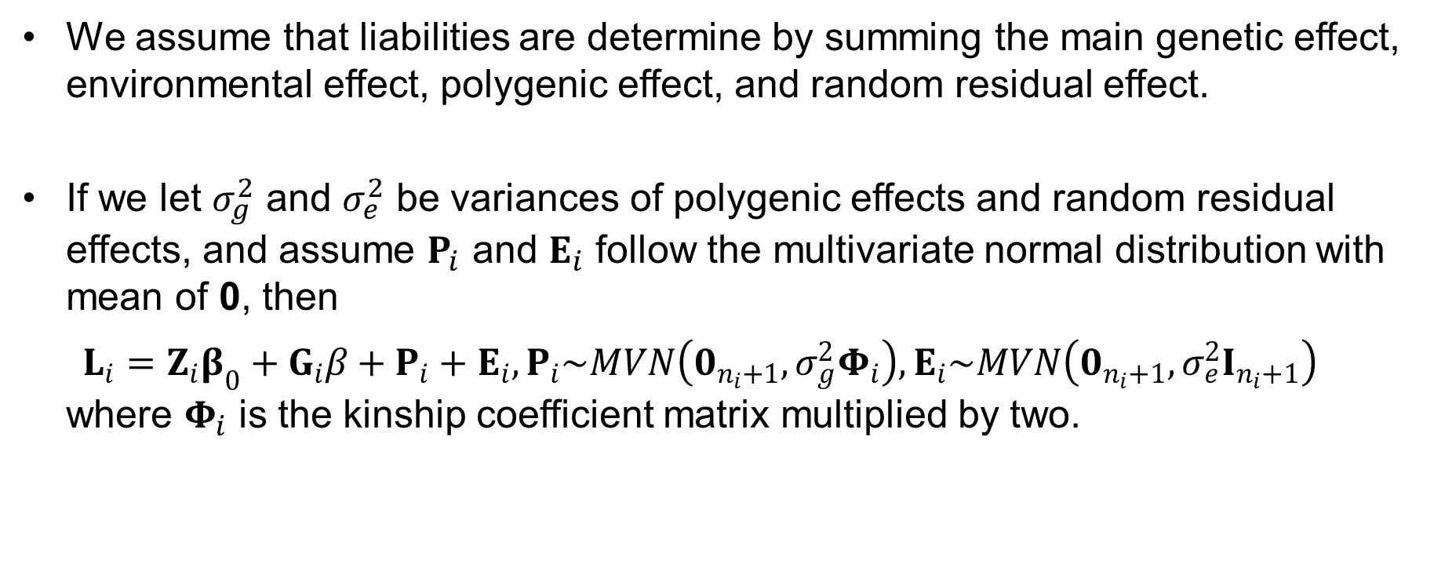
Disease Model
3. Selecting Cases and Controls for GWAS using Family history of Disease
Notations and the disease model
Selection of samples with extreme phenotypes
Statistical power when the family history of disease is controlled
We assume that liabilities are determine by summing the main genetic effect, environmental effect, polygenic effect, and random residual effect.
If we let $σ_{g}^{2}$ and $σ_{e}^{2}$ be variances of polygenic effects and random residual effects, and assume $P_{i}$ and $E_{i}$ follow the multivariate normal distribution with mean of 0, then $L_{i}=Z_{i}β_{0}+G_{i}β+P_{i}+E_{i}, P_{i}\sim MVN\left(0_{n_{i}+1},σ_{g}^{2}Φ_{i}\right), E_{i}\sim MVN\left(0_{n_{i}+1},σ_{e}^{2}I_{n_{i}+1}\right)$ where $Φ_{i}$ is the kinship coefficient matrix multiplied by two.

Slide 22
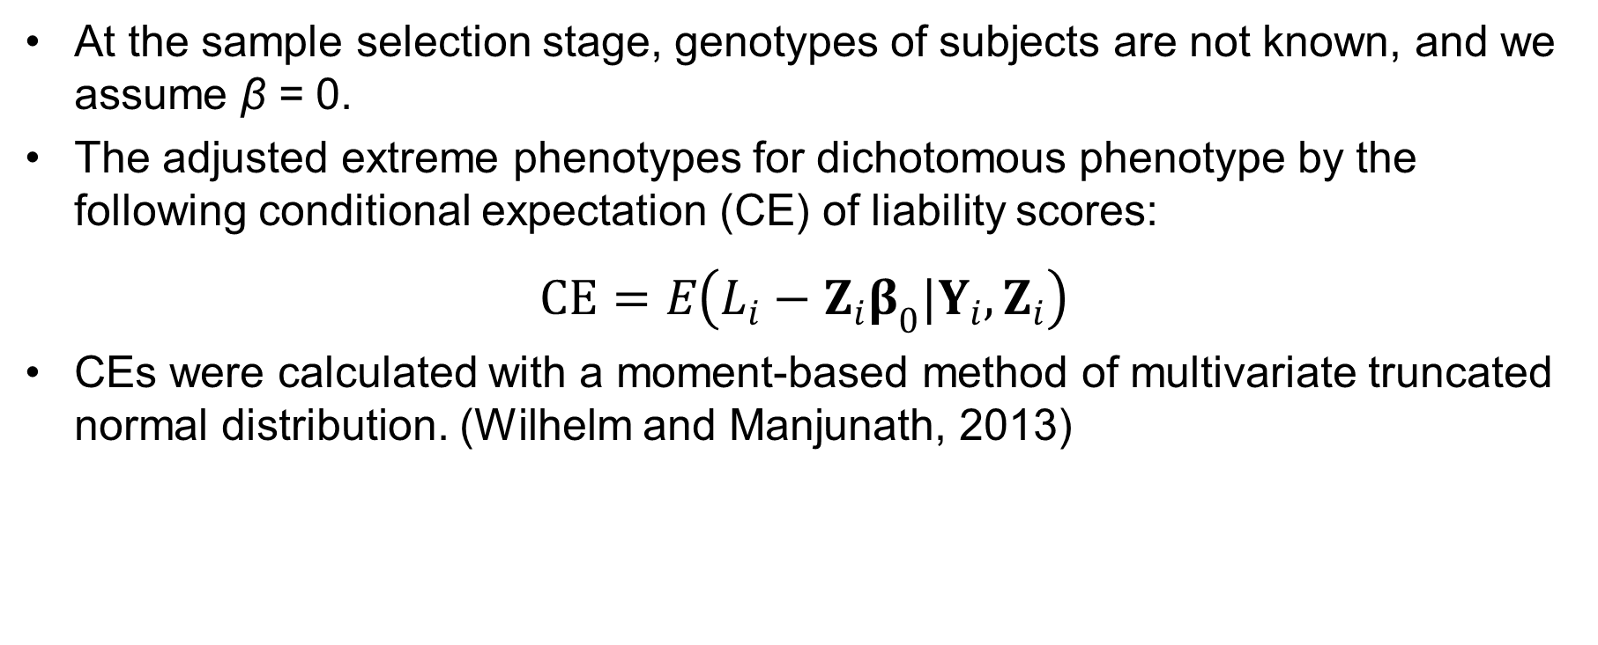
Selection of samples with extreme phenotypes
3. Selecting Cases and Controls for GWAS using Family history of Disease
Notations and the disease model
Selection of samples with extreme phenotypes
Statistical power when the family history of disease is controlled
At the sample selection stage, genotypes of subjects are not known, and we assume β = 0.
The adjusted extreme phenotypes for dichotomous phenotype by the following conditional expectation (CE) of liability scores:
$$CE=E\left(L_{i}−Z_{i}β_{0}|Y_{i},Z_{i}\right)$$
CEs were calculated with a moment-based method of multivariate truncated normal distribution. (Wilhelm and Manjunath, 2013)

Slide 23
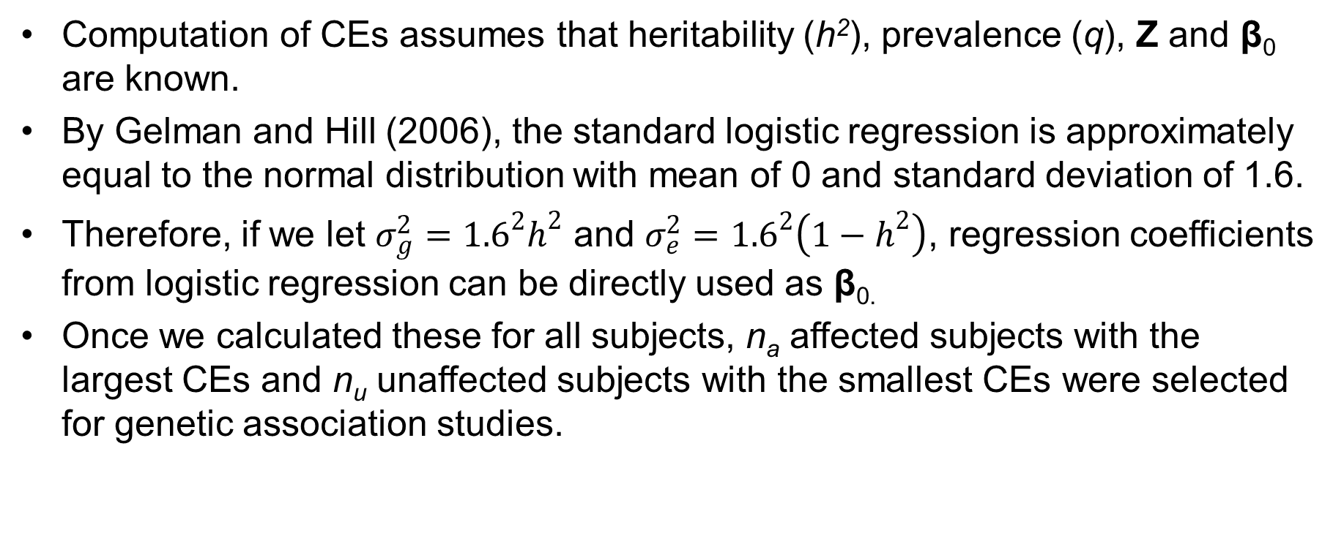
Selection of samples with extreme phenotypes
3. Selecting Cases and Controls for GWAS using Family history of Disease
Notations and the disease model
Selection of samples with extreme phenotypes
Statistical power when the family history of disease is controlled
Computation of CEs assumes that heritability (h²), prevalence (q), Z and β₀ are known.
By Gelman and Hill (2006), the standard logistic regression is approximately equal to the normal distribution with mean of 0 and standard deviation of 1.6.
Therefore, if we let $σ_{g}^{2}={1.6}^{2}h^{2}$ and $σ_{e}^{2}={1.6}^{2}\left(1−h^{2}\right)$, regression coefficients from logistic regression can be directly used as β_{0.}
Once we calculated these for all subjects, n_{a} affected subjects with the largest CEs and n_{u} unaffected subjects with the smallest CEs were selected for genetic association studies.

Slide 24
Simulation Setting
3. Selecting Cases and Controls for GWAS using Family history of Disease
Notations and the disease model
Selection of samples with extreme phenotypes
Simulation study
Three scenarios according to the pedigree structure.
Scenario 1 and 2 consist of the pedigree of following figures respectively.
Scenario 3 are mixture of pedigrees in Scenario 1 and 2.
One causal SNP with MAF of 0.2
No environmental effect
h² : 0.2 and 0.4
q : 0.1 and 0.2
h_{a}² : 0 and 0.005
n : 10,000, n_{a} and n_{u} : 500
2,000 replicates.

Slide 25
Simulation Setting
3. Selecting Cases and Controls for GWAS using Family history of Disease
Notations and the disease model
Selection of samples with extreme phenotypes
Simulation study
We considered five different strategies for selecting cases and controls
Random : Randomly select cases and controls
Highest CE : Select cases or controls with the highest CE
Lowest CE : Select cases or controls with the lowest CE
S6 : the largest (smallest) number of affected first-degree relatives was selected as cases (controls)
 | S1 | S2 | S3 | S4 | S5
Case (500) | Random | Highest CE | Highest CE | Random | Lowest CE
Control (500) | Random | Random | Lowest CE | Lowest CE | Highest CE

Slide 26
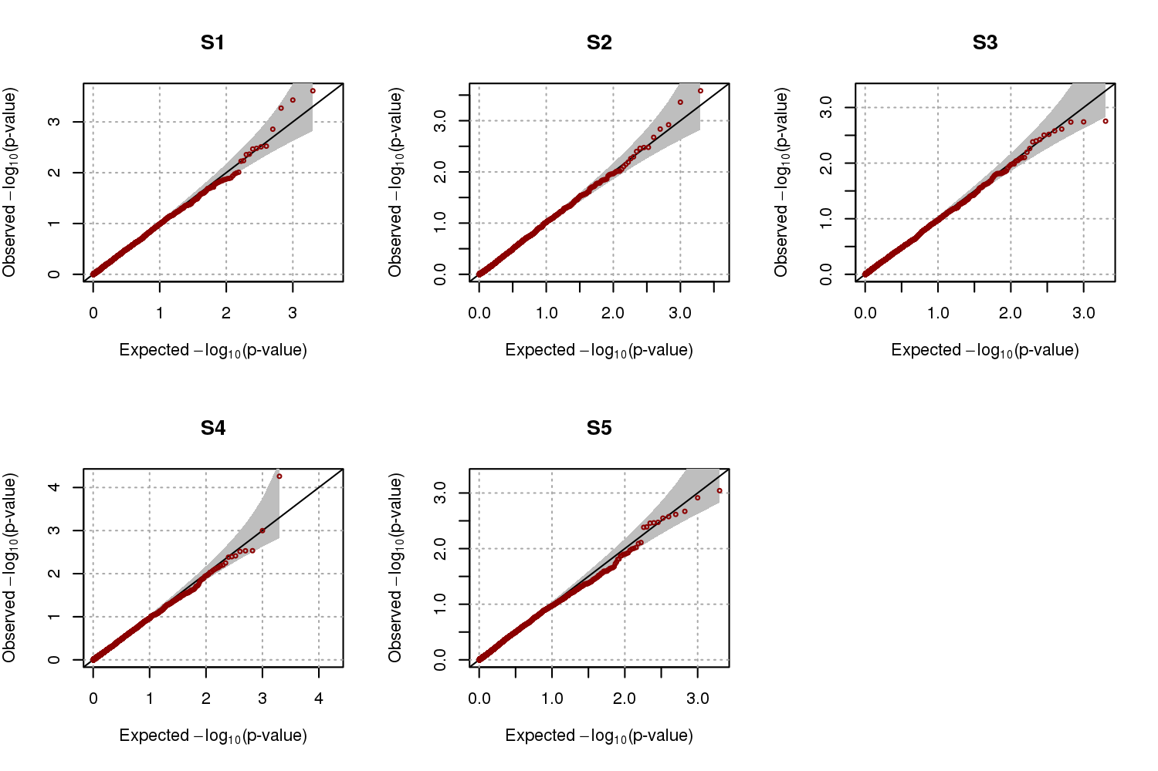
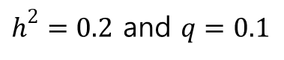
Evaluation of Selection Strategy
3. Selecting Cases and Controls for GWAS using Family history of Disease
Notations and the disease model
Selection of samples with extreme phenotypes
Simulation study
Empirical Type-I error for scenario 1
$h^{2}=0.2$ and $q=0.1$
h² | q | Significance levels | S1 | S2 | S3 | S4 | S5
0.2 | 0.1 | 0.005 | 0.0055 | 0.0065 | 0.0040 | 0.0070 | 0.0050
 |  | 0.01 | 0.0070 | 0.0135 | 0.0090 | 0.0100 | 0.0105
 |  | 0.05 | 0.0515 | 0.0605 | 0.0510 | 0.0525 | 0.0555
 | 0.2 | 0.005 | 0.0020 | 0.0050 | 0.0040 | 0.0070 | 0.0070
 |  | 0.01 | 0.0050 | 0.0090 | 0.0100 | 0.0110 | 0.0115
 |  | 0.05 | 0.0395 | 0.0430 | 0.0550 | 0.0540 | 0.0520
0.4 | 0.1 | 0.005 | 0.0045 | 0.0045 | 0.0050 | 0.0040 | 0.0060
 |  | 0.01 | 0.0090 | 0.0120 | 0.0115 | 0.0085 | 0.0145
 |  | 0.05 | 0.0440 | 0.0475 | 0.0450 | 0.0445 | 0.0495
 | 0.2 | 0.005 | 0.0050 | 0.0050 | 0.0045 | 0.0035 | 0.0070
 |  | 0.01 | 0.0110 | 0.0095 | 0.0085 | 0.0085 | 0.0105
 |  | 0.05 | 0.0555 | 0.0490 | 0.0460 | 0.0470 | 0.0510

Slide 27
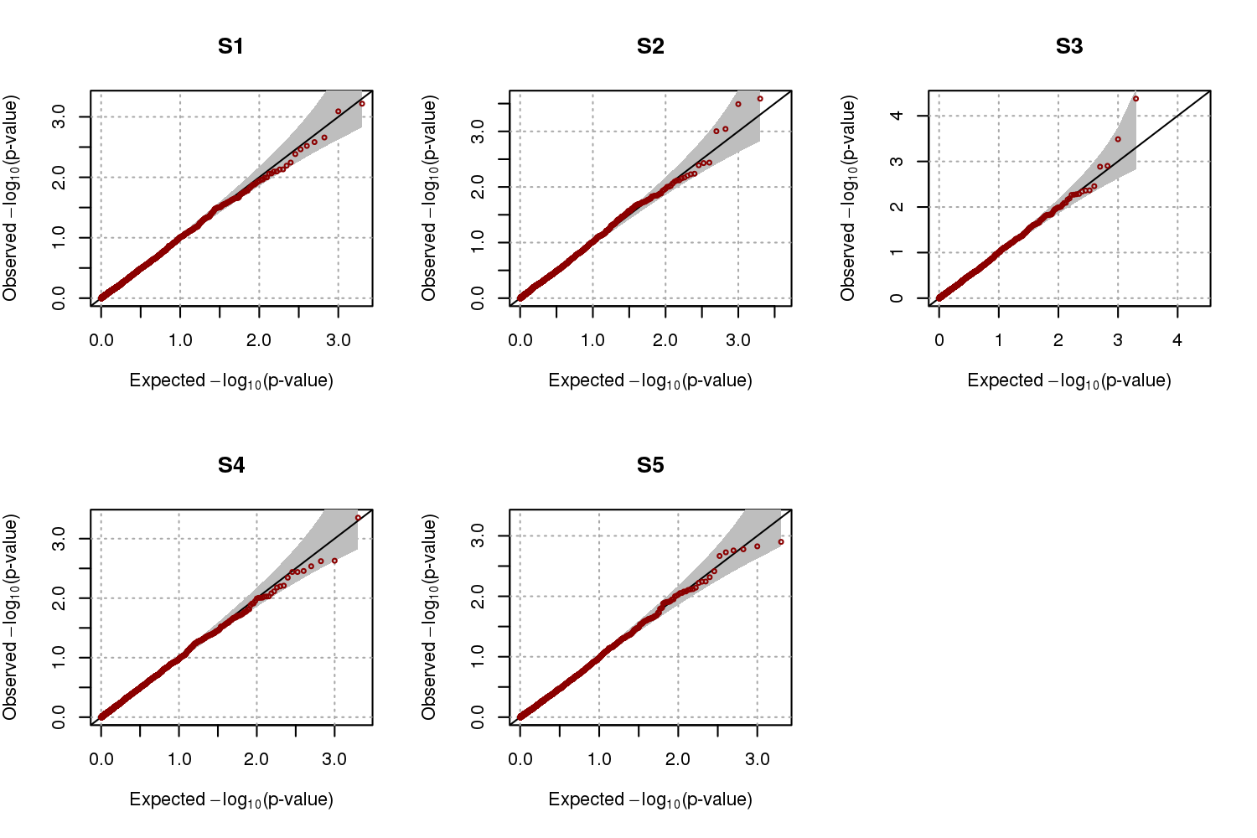
Evaluation of Selection Strategy
3. Selecting Cases and Controls for GWAS using Family history of Disease
Notations and the disease model
Selection of samples with extreme phenotypes
Simulation study
Empirical Type-I error for scenario 2
$h^{2}=0.2$ and $q=0.1$
h² | q | Significance levels | S1 | S2 | S3 | S4 | S5
0.2 | 0.1 | 0.005 | 0.0035 | 0.0035 | 0.0040 | 0.0040 | 0.0040
 |  | 0.01 | 0.0075 | 0.0095 | 0.0090 | 0.0095 | 0.0105
 |  | 0.05 | 0.0500 | 0.0560 | 0.0500 | 0.0500 | 0.0500
 | 0.2 | 0.005 | 0.0070 | 0.0030 | 0.0050 | 0.0065 | 0.0065
 |  | 0.01 | 0.0145 | 0.0095 | 0.0080 | 0.0095 | 0.0090
 |  | 0.05 | 0.0545 | 0.0415 | 0.0455 | 0.0460 | 0.0535
0.4 | 0.1 | 0.005 | 0.0055 | 0.0090 | 0.0075 | 0.0045 | 0.0035
 |  | 0.01 | 0.0100 | 0.0155 | 0.0120 | 0.0090 | 0.0095
 |  | 0.05 | 0.0455 | 0.0555 | 0.0520 | 0.0420 | 0.0440
 | 0.2 | 0.005 | 0.0070 | 0.0050 | 0.0030 | 0.0035 | 0.0055
 |  | 0.01 | 0.0130 | 0.0100 | 0.0075 | 0.0065 | 0.0110
 |  | 0.05 | 0.0530 | 0.0570 | 0.0535 | 0.0500 | 0.0475

Slide 28
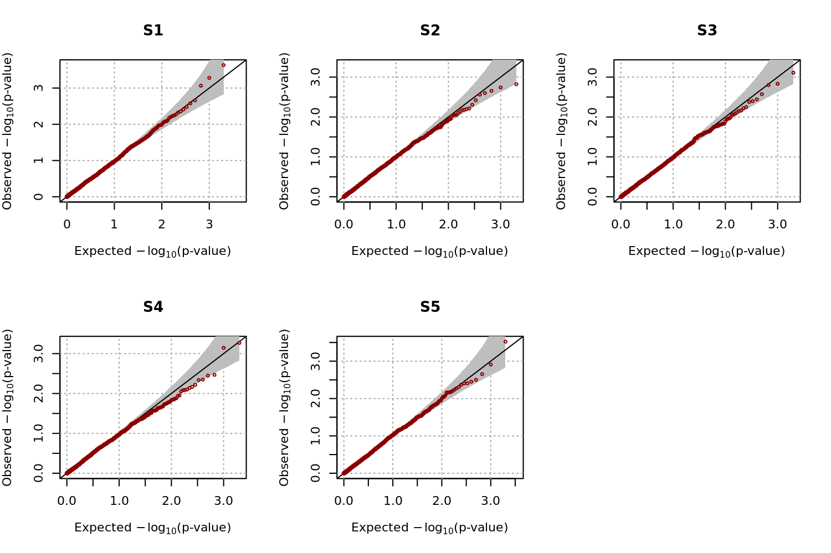
Evaluation of Selection Strategy
3. Selecting Cases and Controls for GWAS using Family history of Disease
Notations and the disease model
Selection of samples with extreme phenotypes
Simulation study
Empirical Type-I error for scenario 3
$h^{2}=0.2$ and $q=0.1$
h² | q | Significance levels | S1 | S2 | S3 | S4 | S5
0.2 | 0.1 | 0.005 | 0.0050 | 0.0045 | 0.0030 | 0.0025 | 0.0035
 |  | 0.01 | 0.0070 | 0.0090 | 0.0080 | 0.0085 | 0.0085
 |  | 0.05 | 0.0470 | 0.0450 | 0.0580 | 0.0525 | 0.0515
 | 0.2 | 0.005 | 0.0040 | 0.0055 | 0.0060 | 0.0070 | 0.0065
 |  | 0.01 | 0.0075 | 0.0090 | 0.0105 | 0.0120 | 0.0135
 |  | 0.05 | 0.0420 | 0.0440 | 0.0570 | 0.0570 | 0.0495
0.4 | 0.1 | 0.005 | 0.0060 | 0.0075 | 0.0055 | 0.0025 | 0.0050
 |  | 0.01 | 0.0095 | 0.0135 | 0.0105 | 0.0095 | 0.0115
 |  | 0.05 | 0.0450 | 0.0560 | 0.0480 | 0.0500 | 0.0515
 | 0.2 | 0.005 | 0.0055 | 0.0040 | 0.0060 | 0.0040 | 0.0045
 |  | 0.01 | 0.0085 | 0.0075 | 0.0120 | 0.0080 | 0.0085
 |  | 0.05 | 0.0475 | 0.0450 | 0.0460 | 0.0480 | 0.0455

Slide 29
Evaluation of Selection Strategy
3. Selecting Cases and Controls for GWAS using Family history of Disease
Notations and the disease model
Selection of samples with extreme phenotypes
Simulation study
Empirical power estimates for scenario 1
h² | q | Significance levels | S1 | S2 | S3 | S4 | S5 | S6
0.2 | 0.1 | 0.005 | 0.2675 | 0.4820 | 0.6635 | 0.4255 | 0.0030 | 0.6645
 |  | 0.01 | 0.3505 | 0.5795 | 0.7450 | 0.5245 | 0.0085 | 0.7450
 |  | 0.05 | 0.5880 | 0.8070 | 0.8980 | 0.7545 | 0.0520 | 0.8980
 | 0.2 | 0.005 | 0.2210 | 0.5520 | 0.8220 | 0.4825 | 0.0095 | 0.8265
 |  | 0.01 | 0.2840 | 0.6515 | 0.8815 | 0.5745 | 0.0195 | 0.8810
 |  | 0.05 | 0.5260 | 0.8480 | 0.9645 | 0.7790 | 0.0930 | 0.9670
0.4 | 0.1 | 0.005 | 0.2700 | 0.4445 | 0.6090 | 0.4325 | 0.0085 | 0.6090
 |  | 0.01 | 0.3525 | 0.5285 | 0.6925 | 0.5130 | 0.0155 | 0.6915
 |  | 0.05 | 0.5950 | 0.7640 | 0.8670 | 0.7530 | 0.0675 | 0.8660
 | 0.2 | 0.005 | 0.1825 | 0.4730 | 0.7010 | 0.4210 | 0.0055 | 0.6935
 |  | 0.01 | 0.2425 | 0.5625 | 0.7825 | 0.5005 | 0.0135 | 0.7780
 |  | 0.05 | 0.4725 | 0.7855 | 0.9215 | 0.7210 | 0.0530 | 0.9225

Slide 30
Evaluation of Selection Strategy
3. Selecting Cases and Controls for GWAS using Family history of Disease
Notations and the disease model
Selection of samples with extreme phenotypes
Simulation study
Empirical power estimates for scenario 2
h² | q | Significance levels | S1 | S2 | S3 | S4 | S5 | S6
0.2 | 0.1 | 0.005 | 0.2715 | 0.4960 | 0.7275 | 0.5165 | 0.0070 | 0.6730
 |  | 0.01 | 0.3555 | 0.5855 | 0.7970 | 0.6160 | 0.0110 | 0.7565
 |  | 0.05 | 0.6115 | 0.8010 | 0.9320 | 0.8240 | 0.0415 | 0.9030
 | 0.2 | 0.005 | 0.1930 | 0.5940 | 0.9000 | 0.5485 | 0.0165 | 0.8115
 |  | 0.01 | 0.2750 | 0.6840 | 0.9310 | 0.6530 | 0.0270 | 0.8685
 |  | 0.05 | 0.5030 | 0.8595 | 0.9775 | 0.8415 | 0.0960 | 0.9565
0.4 | 0.1 | 0.005 | 0.2630 | 0.4355 | 0.6425 | 0.4625 | 0.0060 | 0.5850
 |  | 0.01 | 0.3540 | 0.5285 | 0.7320 | 0.5585 | 0.0120 | 0.6795
 |  | 0.05 | 0.5955 | 0.7495 | 0.8930 | 0.7875 | 0.0555 | 0.8720
 | 0.2 | 0.005 | 0.1910 | 0.5080 | 0.7940 | 0.4870 | 0.0050 | 0.7185
 |  | 0.01 | 0.2695 | 0.5975 | 0.8520 | 0.5800 | 0.0080 | 0.7855
 |  | 0.05 | 0.4985 | 0.8030 | 0.9525 | 0.7885 | 0.0480 | 0.9185

Slide 31
Evaluation of Selection Strategy
3. Selecting Cases and Controls for GWAS using Family history of Disease
Notations and the disease model
Selection of samples with extreme phenotypes
Simulation study
Empirical power estimates for scenario 3
h² | q | Significance levels | S1 | S2 | S3 | S4 | S5 | S6
0.2 | 0.1 | 0.005 | 0.2700 | 0.4970 | 0.7475 | 0.5180 | 0.0045 | 0.6645
 |  | 0.01 | 0.3490 | 0.5825 | 0.8065 | 0.6075 | 0.0095 | 0.7495
 |  | 0.05 | 0.5980 | 0.7950 | 0.9245 | 0.8120 | 0.0405 | 0.9065
 | 0.2 | 0.005 | 0.2135 | 0.5635 | 0.8860 | 0.5770 | 0.0185 | 0.8030
 |  | 0.01 | 0.2850 | 0.6505 | 0.9215 | 0.6595 | 0.0340 | 0.8605
 |  | 0.05 | 0.5380 | 0.8385 | 0.9825 | 0.8565 | 0.1130 | 0.9600
0.4 | 0.1 | 0.005 | 0.2615 | 0.4455 | 0.6375 | 0.4470 | 0.0090 | 0.5935
 |  | 0.01 | 0.3485 | 0.5330 | 0.7205 | 0.5390 | 0.0185 | 0.6810
 |  | 0.05 | 0.5855 | 0.7570 | 0.8795 | 0.7710 | 0.0655 | 0.8450
 | 0.2 | 0.005 | 0.2130 | 0.4695 | 0.7860 | 0.5025 | 0.0090 | 0.7125
 |  | 0.01 | 0.2890 | 0.5775 | 0.8475 | 0.6005 | 0.0175 | 0.7905
 |  | 0.05 | 0.5020 | 0.7890 | 0.9515 | 0.7990 | 0.0570 | 0.9225

Slide 32
Robustness of CE to choices of q and h²
3. Selecting Cases and Controls for GWAS using Family history of Disease
Notations and the disease model
Selection of samples with extreme phenotypes
Simulation study
True setting : h²= 0.3, and q = 0.3
Assumption : (h², q) = (0.1, 0.1), (0.2, 0.2), (0.4, 0.4), and (0.5, 0.5)
Empirical relative power
for Scenario 3
h² | q | Significance levels | S1ª | S2^{b} | S3^{c} | S4^{d} | S5e
0.1 | 0.1 | 0.005 | 102.899 | 100.705 | 99.888 | 100.657 | 88.235
 |  | 0.01 | 103.586 | 99.774 | 99.946 | 99.841 | 92.857
 |  | 0.05 | 100.106 | 98.425 | 100.154 | 100.540 | 100.000
0.2 | 0.2 | 0.005 | 104.348 | 98.325 | 100.503 | 101.221 | 97.059
 |  | 0.01 | 102.110 | 98.417 | 100.270 | 101.351 | 98.214
 |  | 0.05 | 98.301 | 98.308 | 99.897 | 101.439 | 97.222
0.4 | 0.1 | 0.005 | 106.087 | 97.884 | 100.447 | 101.972 | 91.176
 |  | 0.01 | 106.118 | 97.513 | 100.486 | 101.510 | 91.071
 |  | 0.05 | 96.603 | 99.650 | 100.410 | 98.741 | 103.333
0.5 | 0.2 | 0.005 | 95.072 | 101.146 | 100.280 | 102.723 | 88.235
 |  | 0.01 | 99.367 | 99.925 | 100.054 | 103.021 | 94.643
 |  | 0.05 | 102.866 | 99.242 | 100.513 | 100.540 | 104.444

Slide 33
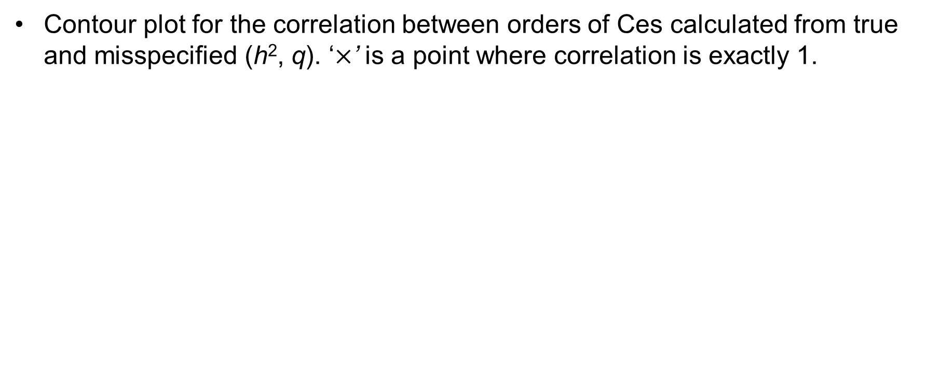
Robustness of CE to choices of q and h²
3. Selecting Cases and Controls for GWAS using Family history of Disease
Notations and the disease model
Selection of samples with extreme phenotypes
Simulation study
Contour plot for the correlation between orders of Ces calculated from true and misspecified (h², q). ‘$×$’ is a point where correlation is exactly 1.

Slide 34
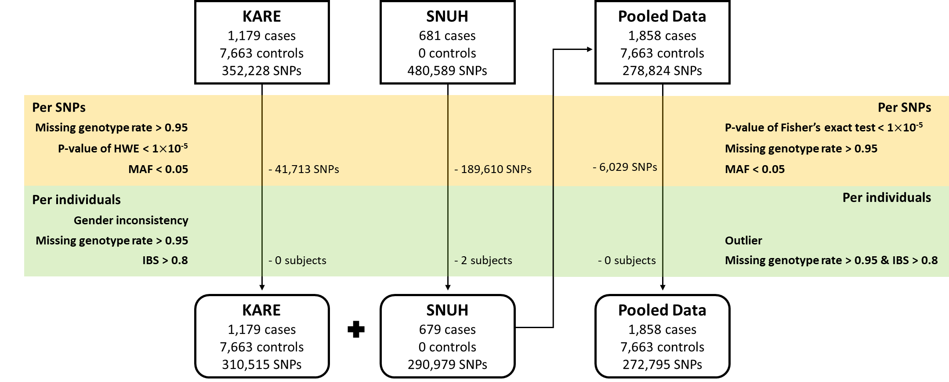
Application to GWAS of Type 2 Diabetes
3. Selecting Cases and Controls for GWAS using Family history of Disease
Application to GWAS of T2D
Discussion
Data Description and Quality Control
Selecting 1,000 cases and 4,000 controls

Slide 35
Application to GWAS of Type 2 Diabetes
3. Selecting Cases and Controls for GWAS using Family history of Disease
Application to GWAS of T2D
Discussion
Family history
In the KARE cohort, the disease status of relatives was collected by a survey from all participants, and 1,037 subjects answered that they have affected relatives. (1,230 affected relatives were available)
In the SNUH cohort, the disease status of relatives was obtained based on the recall of the proband. In total, the disease statuses of 7,825 relatives were available, among which 2,875 subjects had T2D.

Slide 36
Application to GWAS of Type 2 Diabetes
3. Selecting Cases and Controls for GWAS using Family history of Disease
Application to GWAS of T2D
Discussion
Prevalence of T2D in Korea
About 9.9% of adults over 30 years of age were expected to have T2D in 2009 (Kim, D. J. (2011). The epidemiology of diabetes in Korea. Diabetes & metabolism journal, 35(4), 303-308.)
Heritability of T2D
It has been reported to be approximately 26% (Poulsen, P., Kyvik, K. O., Vaag, A., & Beck-Nielsen, H. (1999). Heritability of type II (non-insulin-dependent) diabetes mellitus and abnormal glucose tolerance–a population-based twin study. Diabetologia, 42(2), 139-145.)
We included top ten PC scores, sex, age and squared age as covariates for GWAS.

Slide 37
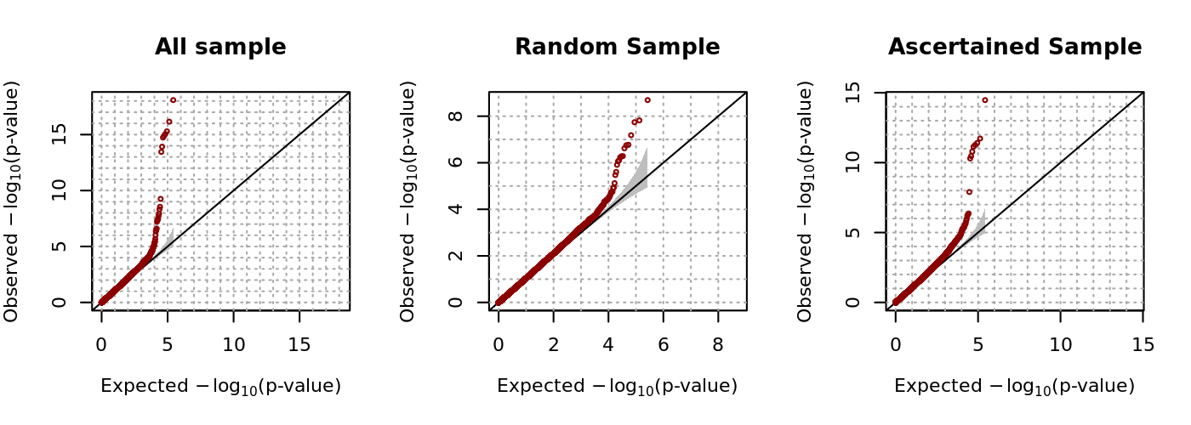
Application to GWAS of Type 2 Diabetes
3. Selecting Cases and Controls for GWAS using Family history of Disease
Application to GWAS of T2D
Discussion
QQ plots for the results from GWAS of T2D

Slide 38
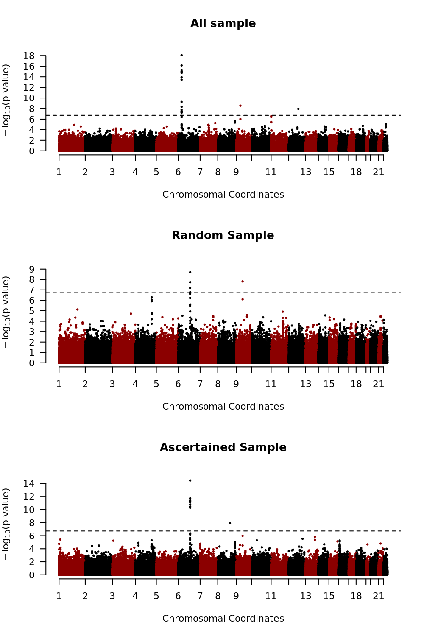
Application to GWAS of Type 2 Diabetes
3. Selecting Cases and Controls for GWAS using Family history of Disease
Application to GWAS of T2D
Discussion
Manhattan plots for the results from genome-wide association study (GWAS) of type 2 diabetes.

Slide 39
Application to GWAS of Type 2 Diabetes
3. Selecting Cases and Controls for GWAS using Family history of Disease
Application to GWAS of T2D
Discussion
Results of GWAS. Genome-wide significance level was 1.872 x 10⁻⁷.
SNP | CHR | POS | Gene | GWAS using all subjects | GWAS using S1 | GWAS using S3
rs10946398 | 6 | 20661034 | CDKAL1 | 8.25×10⁻¹⁹ | 2.03×10⁻⁹ | 3.35×10⁻¹⁵
rs7754840 | 6 | 20661250 | CDKAL1 | 7.03×10⁻¹⁷ | 1.82×10⁻⁸ | 1.88×10⁻¹²
rs9460546 | 6 | 20663632 | CDKAL1 | 5.10×10⁻¹⁶ | 6.53×10⁻⁸ | 3.91×10⁻¹²
rs9465871 | 6 | 20717255 | CDKAL1 | 8.91×10⁻¹⁶ | 2.40×10⁻⁷ | 1.61×10⁻¹¹
rs7747752 | 6 | 20725423 | CDKAL1 | 1.31×10⁻¹⁵ | 1.69×10⁻⁷ | 5.39×10⁻¹²
rs7767391 | 6 | 20725240 | CDKAL1 | 1.84×10⁻¹⁵ | 1.78×10⁻⁷ | 7.21×10⁻¹²
rs9348440 | 6 | 20641336 | CDKAL1 | 1.20×10⁻¹⁴ | 5.90×10⁻⁷ | 3.35×10⁻¹¹
rs2328549 | 6 | 20718240 | CDKAL1 | 3.53×10⁻¹⁴ | 2.48×10⁻⁶ | 5.02×10⁻¹¹
rs10811661 | 9 | 22134094 | CDKN2B-AS1 | 2.84×10⁻⁹ | 1.51×10⁻⁸ | 1.04×10⁻⁶
SNP | CHR | POS | Gene | GWAS using all subjects | GWAS using S1 | GWAS using S3
rs7741604 | 6 | 20731524 | CDKAL1 | 4.74×10⁻⁹ | 1.16×10⁻⁵ | 2.23×10⁻⁶
rs1526959 | 12 | 79753790 | SYT1 | 1.16×10⁻⁸ | 3.00×10⁻³ | 2.89×10⁻⁶
rs4291090 | 6 | 20570039 | CDKAL1 | 1.81×10⁻⁸ | 3.20×10⁻⁴ | 6.40×10⁻⁷
rs2820001 | 6 | 20758943 | CDKAL1 | 3.23×10⁻⁸ | 9.19×10⁻⁵ | 2.05×10⁻⁵
rs10946406 | 6 | 20758760 | CDKAL1 | 4.01×10⁻⁸ | 1.61×10⁻² | 5.02×10⁻⁷
rs2294809 | 6 | 20599888 | CDKAL1 | 4.52×10⁻⁸ | 4.90×10⁻⁴ | 2.41×10⁻⁶
rs9366357 | 6 | 20599628 | CDKAL1 | 6.09×10⁻⁸ | 4.34×10⁻⁴ | 4.22×10⁻⁶
rs12679402 | 8 | 41958980 | AP3M2 | 8.45×10⁻⁵ | 2.53×10⁻³ | 1.26×10⁻⁸

Slide 40
Conclusion and Discussion
3. Selecting Cases and Controls for GWAS using Family history of Disease
Application to GWAS of T2D
Conclusion and Discussion
In this report, a new statistical method for selecting the most informative cases and controls based on the family history of disease was proposed.
The proposed method simultaneously takes into account both familial distance and number of relatives.
Selecting cases and controls using this method leads to a substantial improvement in statistical power.

Slide 41
Conclusion and Discussion
3. Selecting Cases and Controls for GWAS using Family history of Disease
Application to GWAS of T2D
Conclusion and Discussion
Limitation
Model assumption (Multivariate normal distribution)
Recall bias for the family history of disease
Heritability and prevalence should be known
Nevertheless, Our results reveal that additional statistical power can be achieved in association analyses with careful selection of cases and controls
The family history of disease is very useful for this purpose
Notes:
the proposed method may be a useful strategy for improving the success of genome-wide association analyses

Slide 42
Heritability Estimation and Genetic Association Study in Family-based Design for the Disease on the Binary Trait using Liability Threshold Model
Notations and the disease model
Estimation of the parameters using the EM algorithm
Conditional expected score test
Simulation study
Application to GWAS of LAM
Application to heritability estimation of CRC
Discussion

Slide 43
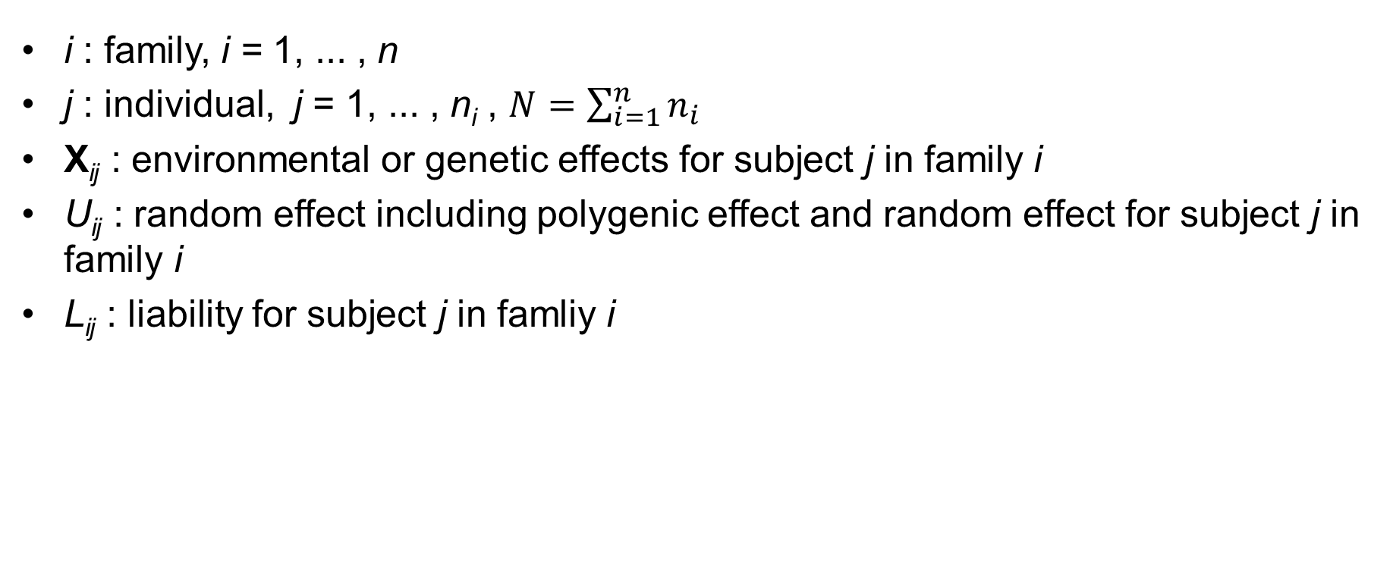
Notations
4. Heritability Estimation and Genetic Association Study on the Binary Trait
Notations and the disease model
Estimation of the parameters using the EM algorithm
Conditional expected score test
i : family, i = 1, ... , n
j : individual, j = 1, ... , n_{i} , $N=\sum_{i=1}^{n}{n_{i}}$
X_{ij} : environmental or genetic effects for subject j in family i
U_{ij} : random effect including polygenic effect and random effect for subject j in family i
L_{ij} : liability for subject j in famliy i

Slide 44
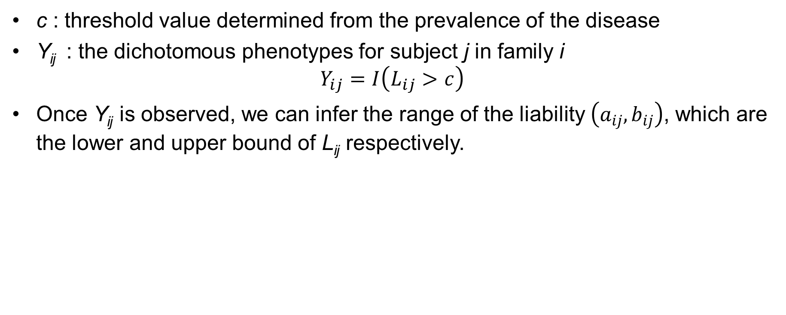
Notations
4. Heritability Estimation and Genetic Association Study on the Binary Trait
Notations and the disease model
Estimation of the parameters using the EM algorithm
Conditional expected score test
c : threshold value determined from the prevalence of the disease
Y_{ij} : the dichotomous phenotypes for subject j in family i $Y_{ij}=I\left(L_{ij}>c\right)$
Once Y_{ij} is observed, we can infer the range of the liability $\left(a_{ij},b_{ij}\right)$, which are the lower and upper bound of L_{ij} respectively.

Slide 45
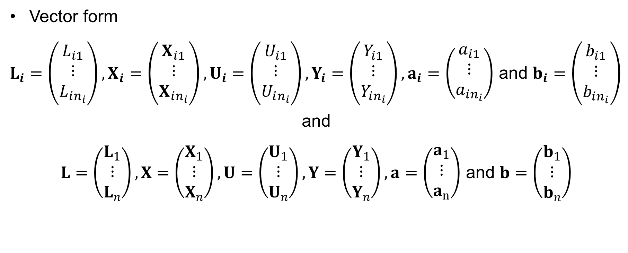
Notations
4. Heritability Estimation and Genetic Association Study on the Binary Trait
Notations and the disease model
Estimation of the parameters using the EM algorithm
Conditional expected score test
Vector form
$L_{i}=\left(\begin{matrix}L_{i1} \\ ⋮ \\ L_{in_{i}}\end{matrix}\right), X_{i}=\left(\begin{matrix}X_{i1} \\ ⋮ \\ X_{in_{i}}\end{matrix}\right), U_{i}=\left(\begin{matrix}U_{i1} \\ ⋮ \\ U_{in_{i}}\end{matrix}\right), Y_{i}=\left(\begin{matrix}Y_{i1} \\ ⋮ \\ Y_{in_{i}}\end{matrix}\right), a_{i}=\left(\begin{matrix}a_{i1} \\ ⋮ \\ a_{in_{i}}\end{matrix}\right)$ and $b_{i}=\left(\begin{matrix}b_{i1} \\ ⋮ \\ b_{in_{i}}\end{matrix}\right)$
and
$L=\left(\begin{matrix}L_{1} \\ ⋮ \\ L_{n}\end{matrix}\right),X=\left(\begin{matrix}X_{1} \\ ⋮ \\ X_{n}\end{matrix}\right),U=\left(\begin{matrix}U_{1} \\ ⋮ \\ U_{n}\end{matrix}\right), Y=\left(\begin{matrix}Y_{1} \\ ⋮ \\ Y_{n}\end{matrix}\right), a=\left(\begin{matrix}a_{1} \\ ⋮ \\ a_{n}\end{matrix}\right)$ and $b=\left(\begin{matrix}b_{1} \\ ⋮ \\ b_{n}\end{matrix}\right)$

Slide 46
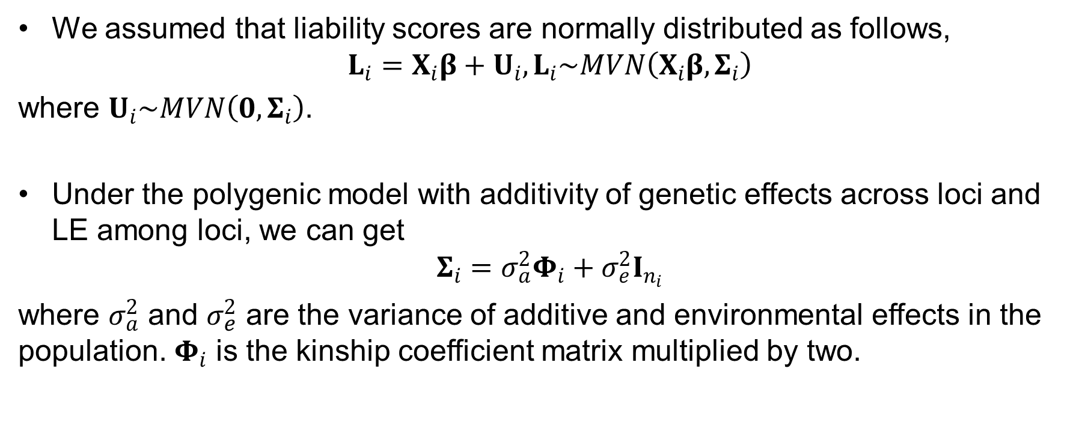
Disease Model
4. Heritability Estimation and Genetic Association Study on the Binary Trait
Notations and the disease model
Estimation of the parameters using the EM algorithm
Conditional expected score test
We assumed that liability scores are normally distributed as follows,
$$L_{i}=X­_{i}β+U_{i}, L_{i}\sim MVN\left(X­_{i}β,Σ_{i}\right)$$
where $U_{i}\sim MVN\left(0,Σ_{i}\right)$.
Under the polygenic model with additivity of genetic effects across loci and LE among loci, we can get
$$Σ_{i}=σ_{a}^{2}Φ_{i}+σ_{e}^{2}I_{n_{i}}$$
where $σ_{a}^{2}$ and $σ_{e}^{2}$ are the variance of additive and environmental effects in the population. $Φ_{i}$ is the kinship coefficient matrix multiplied by two.

Slide 47
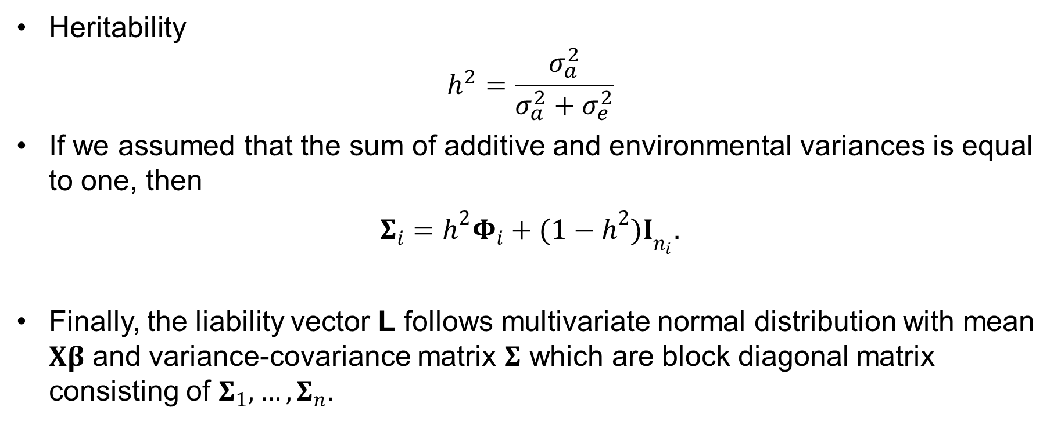
Disease Model
4. Heritability Estimation and Genetic Association Study on the Binary Trait
Notations and the disease model
Estimation of the parameters using the EM algorithm
Conditional expected score test
Heritability
$$h^{2}=\frac{σ_{a}^{2}}{σ_{a}^{2}+σ_{e}^{2}}$$
If we assumed that the sum of additive and environmental variances is equal to one, then
$Σ_{i}={h^{2}Φ}_{i}+{(1−h^{2})I}_{n_{i}}$.
Finally, the liability vector L follows multivariate normal distribution with mean $Xβ$ and variance-covariance matrix $Σ$ which are block diagonal matrix consisting of $Σ_{1},…, Σ_{n}$.

Slide 48


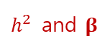
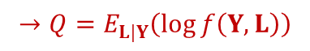
Estimation of the parameters
4. Heritability Estimation and Genetic Association Study on the Binary Trait
Notations and the disease model
Estimation of the parameters using the EM algorithm
Conditional expected score test
EM algorithm (Dempster et al., 1977) : an iterative method to find maximum likelihood estimates of parameters in statistical models, where the model depends on unobserved latent variables.
Procedure
Define complete data consisting of observed variable & unobserved (missing, latent) variable
Obtain the joint log likelihood function of observed and unobserved variables
Take conditional expectation given observed variable to the joint log likelihood function and denote it as Q
Calculate maximizer of Q with respect to the parameter of interest
Update Step 3, 4 and iterate until convergence
$$Y$$
$$L$$
$$→Q=E_{L|Y}\left(\log{f\left(Y,L\right)}\right)$$
$h^{2}$ and $β$

Slide 49
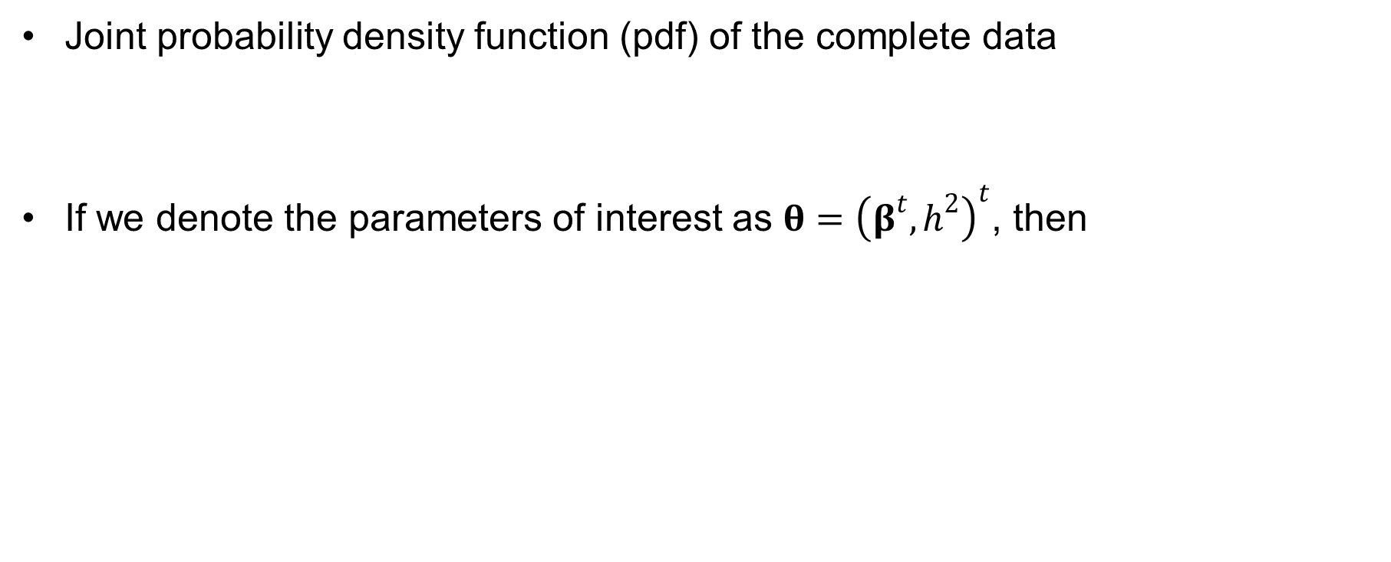
Estimation of the parameters
4. Heritability Estimation and Genetic Association Study on the Binary Trait
Notations and the disease model
Estimation of the parameters using the EM algorithm
Conditional expected score test
Joint probability density function (pdf) of the complete data
If we denote the parameters of interest as $θ={\left(β^{t},h^{2}\right)}^{t}$, then

Slide 50
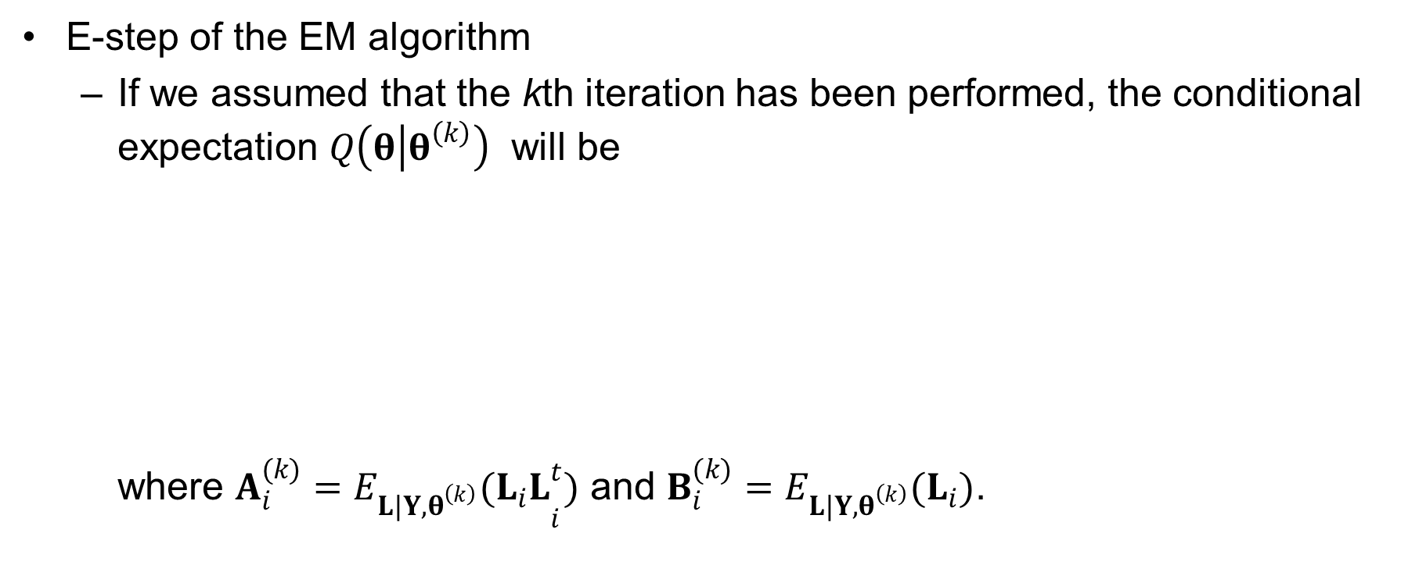
Estimation of the parameters
4. Heritability Estimation and Genetic Association Study on the Binary Trait
Notations and the disease model
Estimation of the parameters using the EM algorithm
Conditional expected score test
E-step of the EM algorithm
If we assumed that the kth iteration has been performed, the conditional expectation $Q\left(θ | θ^{\left(k\right)}\right)$ will be where $A_{i}^{(k)}={E_{L|Y,θ^{\left(k\right)}}(L_{i}L}_{i}^{t})$ and $B_{i}^{(k)}=E_{L|Y,θ^{\left(k\right)}}(L_{i})$.

Slide 51
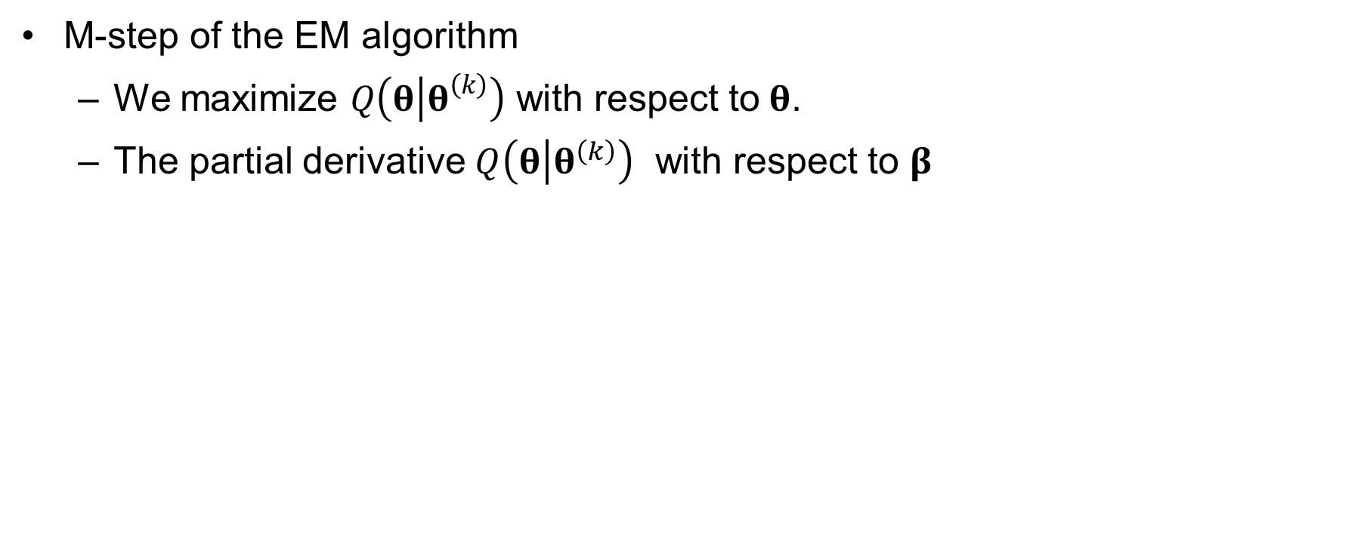
Estimation of the parameters
4. Heritability Estimation and Genetic Association Study on the Binary Trait
Notations and the disease model
Estimation of the parameters using the EM algorithm
Conditional expected score test
M-step of the EM algorithm
We maximize $Q\left(θ | θ^{\left(k\right)}\right)$ with respect to$θ$.
The partial derivative $Q\left(θ | θ^{\left(k\right)}\right)$ with respect to $β$

Slide 52
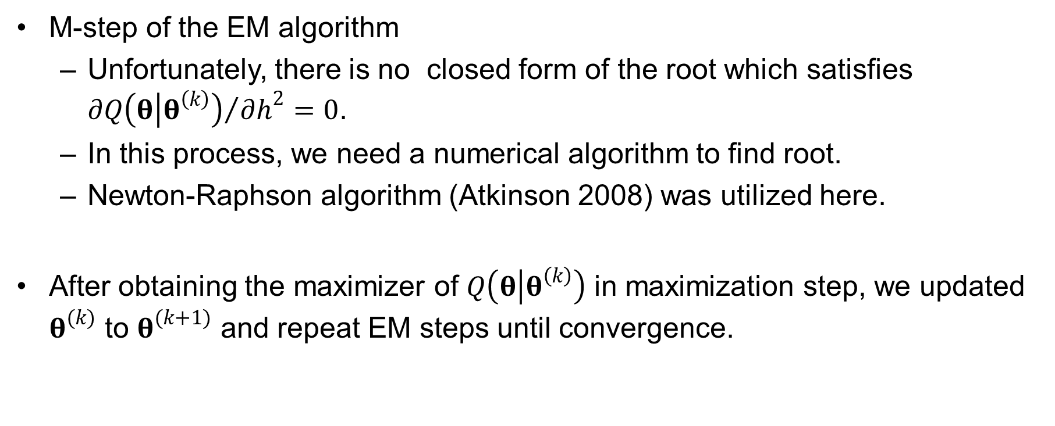
Estimation of the parameters
4. Heritability Estimation and Genetic Association Study on the Binary Trait
Notations and the disease model
Estimation of the parameters using the EM algorithm
Conditional expected score test
M-step of the EM algorithm
Unfortunately, there is no closed form of the root which satisfies ${∂Q\left(θ | θ^{\left(k\right)}\right)}/{∂h^{2}}=0$.
In this process, we need a numerical algorithm to find root.
Newton-Raphson algorithm (Atkinson 2008) was utilized here.
After obtaining the maximizer of $Q\left(θ | θ^{\left(k\right)}\right)$ in maximization step, we updated $θ^{(k)}$ to $θ^{(k+1)}$ and repeat EM steps until convergence.

Slide 53
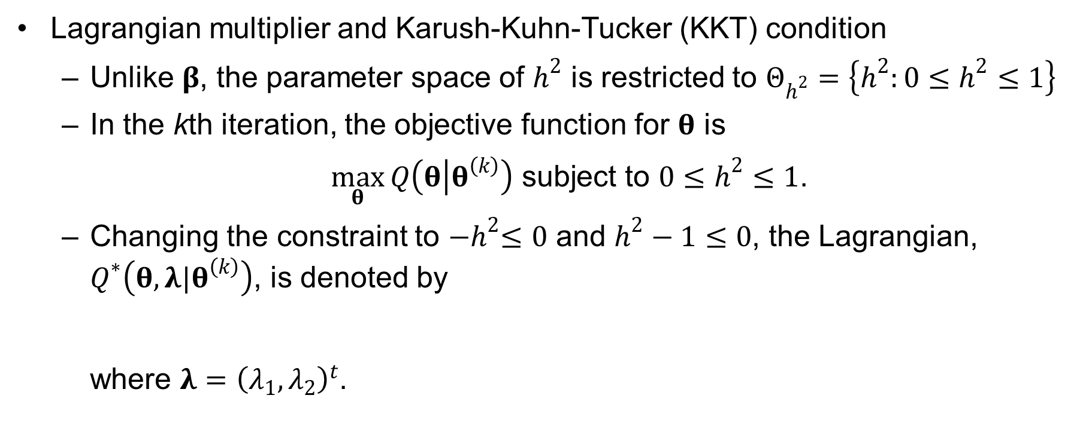
Estimation of the parameters
4. Heritability Estimation and Genetic Association Study on the Binary Trait
Notations and the disease model
Estimation of the parameters using the EM algorithm
Conditional expected score test
Lagrangian multiplier and Karush-Kuhn-Tucker (KKT) condition
Unlike $β$, the parameter space of $h^{2}$ is restricted to $Θ_{h^{2}}=\left\{h^{2}:0≤h^{2}≤1\right\}$
In the kth iteration, the objective function for $θ$ is
$\max_{θ}{Q\left(θ | θ^{\left(k\right)}\right)}$ subject to $0≤h^{2}≤1$.
Changing the constraint to ${−h}^{2}≤0$ and $h^{2}−1≤0$, the Lagrangian, $Q^{∗}\left(θ,λ|θ^{\left(k\right)}\right)$, is denoted by where $λ={\left(λ_{1},λ_{2}\right)}^{t}$.

Slide 54
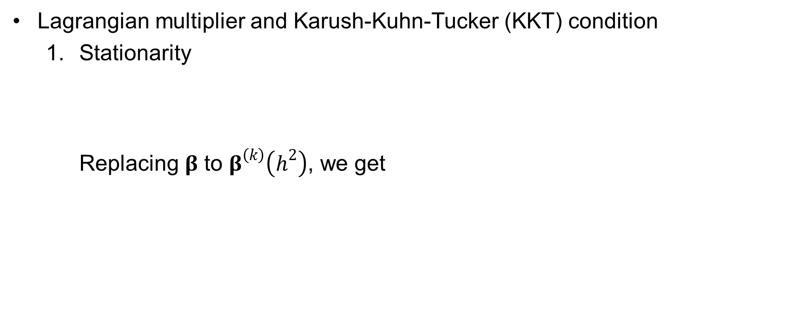
Estimation of the parameters
4. Heritability Estimation and Genetic Association Study on the Binary Trait
Notations and the disease model
Estimation of the parameters using the EM algorithm
Conditional expected score test
Lagrangian multiplier and Karush-Kuhn-Tucker (KKT) condition
Stationarity Replacing $β$ to $β^{\left(k\right)}\left(h^{2}\right)$, we get

Slide 55
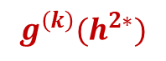
Estimation of the parameters
4. Heritability Estimation and Genetic Association Study on the Binary Trait
Notations and the disease model
Estimation of the parameters using the EM algorithm
Conditional expected score test
Lagrangian multiplier and Karush-Kuhn-Tucker (KKT) condition
Stationarity
and it is equivalent to
$$g^{\left(k\right)}(h^{2∗})$$

Slide 56
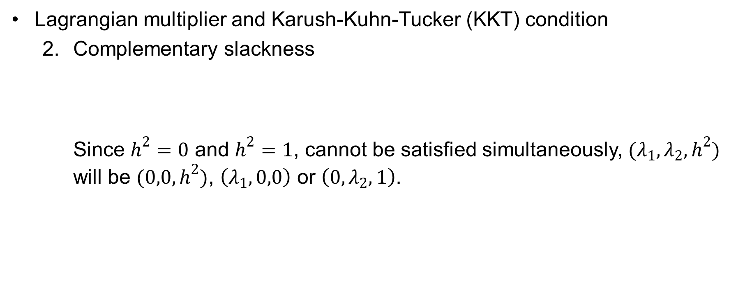
Estimation of the parameters
4. Heritability Estimation and Genetic Association Study on the Binary Trait
Notations and the disease model
Estimation of the parameters using the EM algorithm
Conditional expected score test
Lagrangian multiplier and Karush-Kuhn-Tucker (KKT) condition
Complementary slackness Since $h^{2}=0$ and $h^{2}=1$, cannot be satisfied simultaneously, $(λ_{1},λ_{2},h^{2})$ will be $(0,0,h^{2})$, $\left(λ_{1},0,0\right)$ or $\left(0,λ_{2},1\right)$.

Slide 57
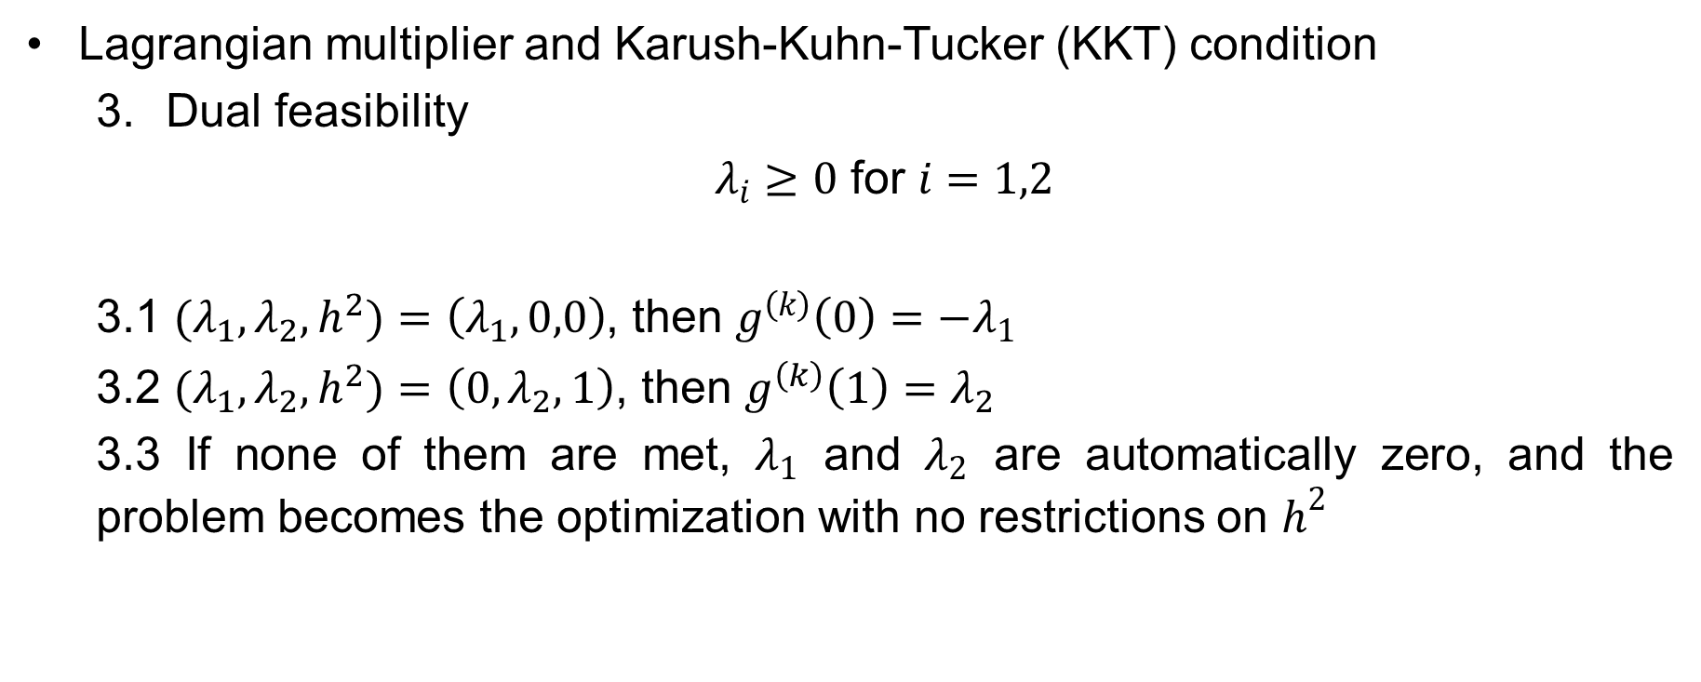
Estimation of the parameters
4. Heritability Estimation and Genetic Association Study on the Binary Trait
Notations and the disease model
Estimation of the parameters using the EM algorithm
Conditional expected score test
Lagrangian multiplier and Karush-Kuhn-Tucker (KKT) condition
Dual feasibility
$λ_{i}≥0$ for $i=1,2$
3.1 $(λ_{1},λ_{2},h^{2})$ $=\left(λ_{1},0,0\right)$, then $g^{\left(k\right)}\left(0\right)={−λ}_{1}$
3.2 $(λ_{1},λ_{2},h^{2})$ $=\left(0,λ_{2},1\right)$, then $g^{\left(k\right)}\left(1\right)=λ_{2}$
3.3 If none of them are met, $λ_{1}$ and $λ_{2}$ are automatically zero, and the problem becomes the optimization with no restrictions on $h^{2}$

Slide 58
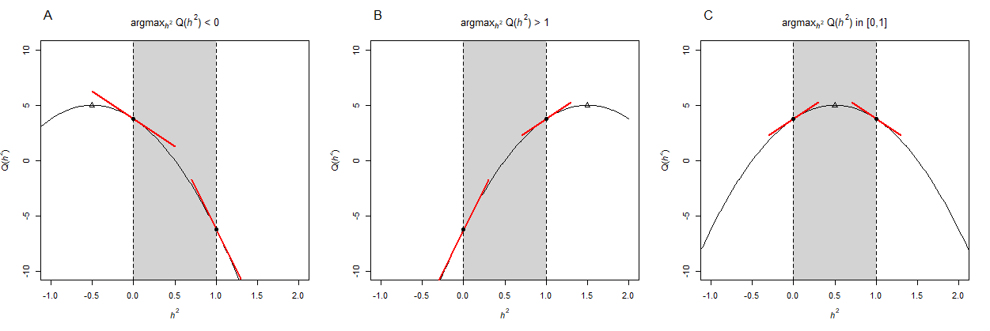
Estimation of the parameters
4. Heritability Estimation and Genetic Association Study on the Binary Trait
Notations and the disease model
Estimation of the parameters using the EM algorithm
Conditional expected score test
Illustration of KKT condition using a toy example

Slide 59
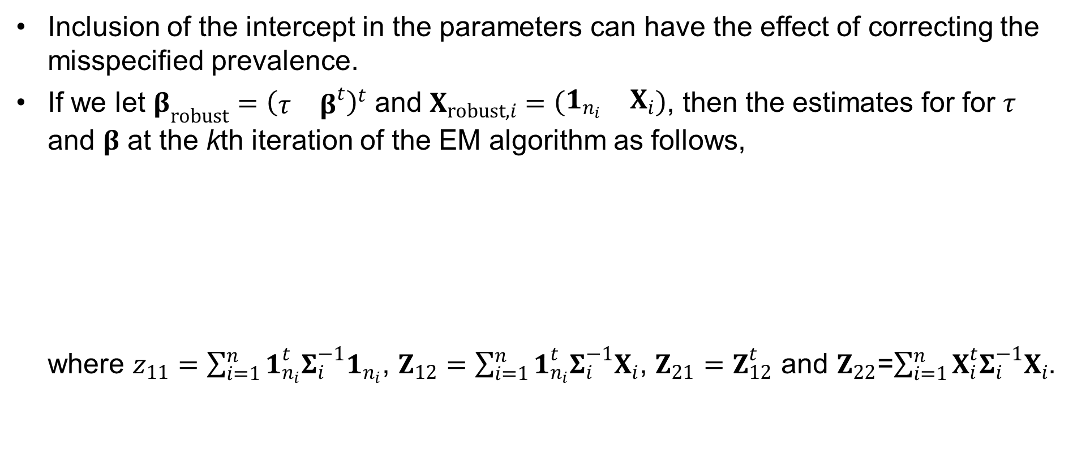
Robust Estimator to the Misspecified q
4. Heritability Estimation and Genetic Association Study on the Binary Trait
Notations and the disease model
Estimation of the parameters using the EM algorithm
Conditional expected score test
Inclusion of the intercept in the parameters can have the effect of correcting the misspecified prevalence.
If we let $β_{robust}={\left(\begin{matrix}τ & β^{t}\end{matrix}\right)}^{t}$ and $X_{robust,i}=\left(\begin{matrix}1_{n_{i}} & X_{i}\end{matrix}\right)$, then the estimates for for $τ$ and $β$ at the kth iteration of the EM algorithm as follows, where $z_{11}=\sum_{i=1}^{n}{1_{n_{i}}^{t}Σ_{i}^{−1}1_{n_{i}}}$, $Z_{12}=\sum_{i=1}^{n}{1_{n_{i}}^{t}Σ_{i}^{−1}X_{i}}$, $Z_{21}=Z_{12}^{t}$ and $Z_{22}$=$\sum_{i=1}^{n}{X_{i}^{t}Σ_{i}^{−1}X_{i}}$.

Slide 60
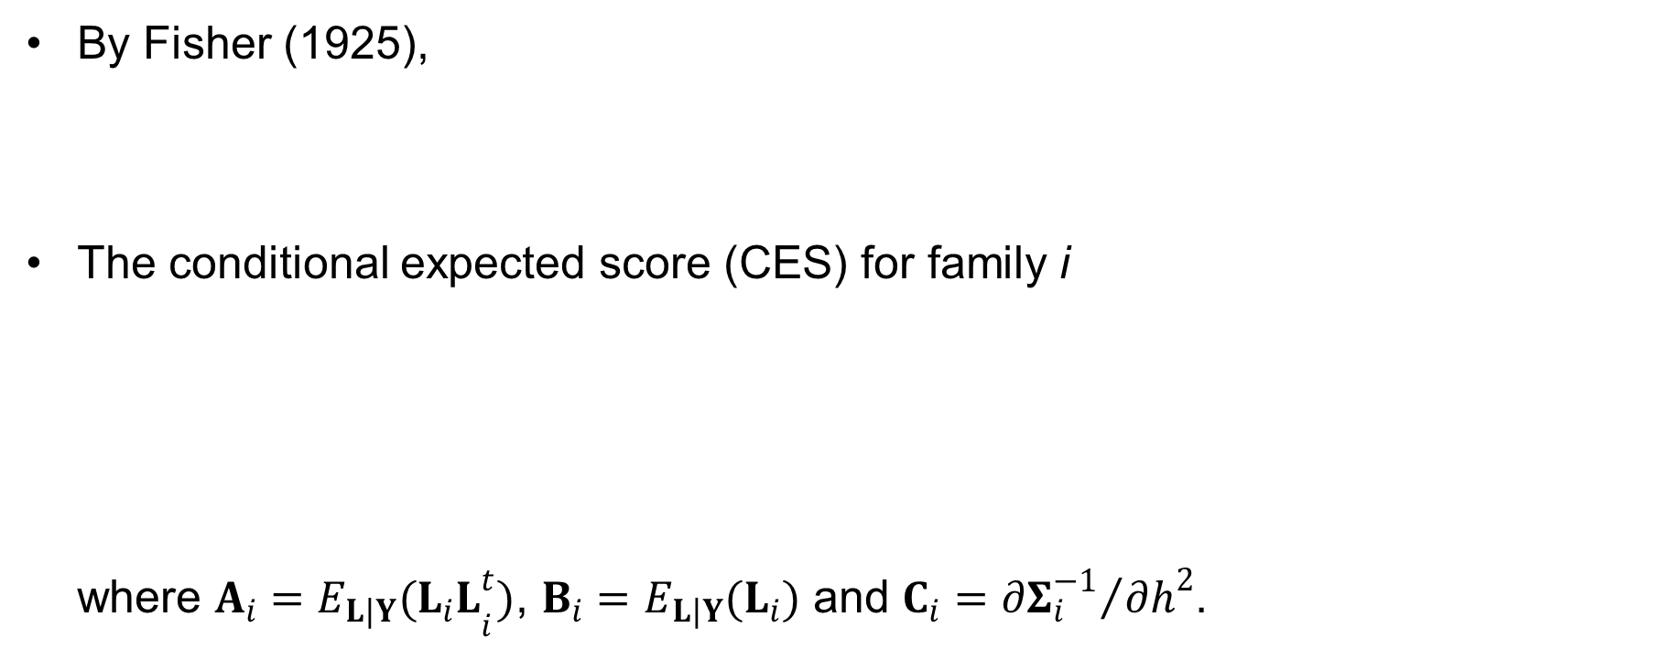
Conditional Expected Score Test (CEST)
4. Heritability Estimation and Genetic Association Study on the Binary Trait
Notations and the disease model
Estimation of the parameters using the EM algorithm
Conditional expected score test
By Fisher (1925),
The conditional expected score (CES) for family i where $A_{i}={E_{L|Y}(L_{i}L}_{i}^{t})$, $B_{i}=E_{L|Y}(L_{i})$ and $C_{i}={∂Σ_{i}^{−1}}/{∂h^{2}}$.

Slide 61
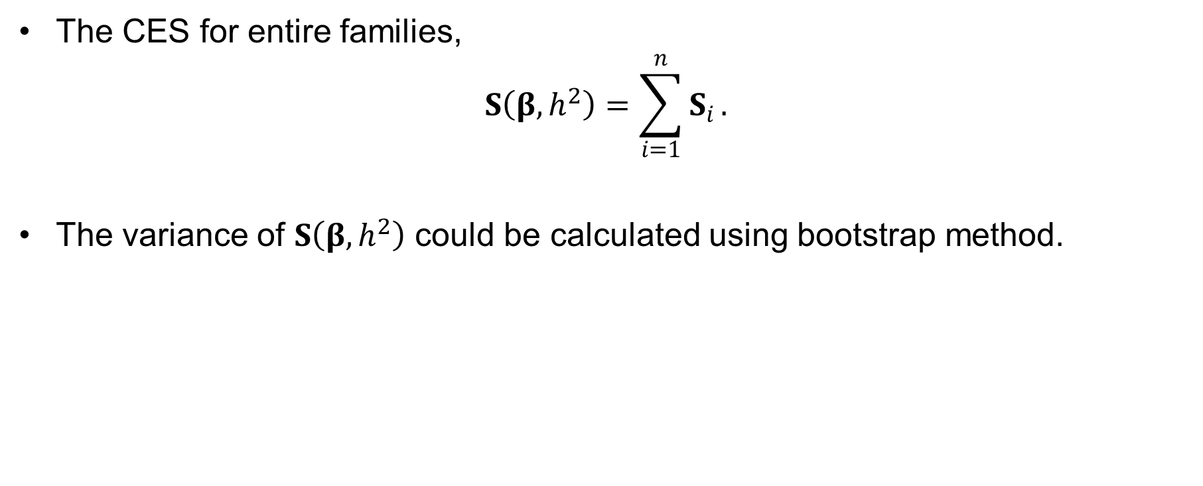
Conditional Expected Score Test (CEST)
4. Heritability Estimation and Genetic Association Study on the Binary Trait
Notations and the disease model
Estimation of the parameters using the EM algorithm
Conditional expected score test
The CES for entire families,
$$S\left(β,h^{2}\right)=\sum_{i=1}^{n}{S_{i}}.$$
The variance of $S\left(β,h^{2}\right)$ could be calculated using bootstrap method.

Slide 62
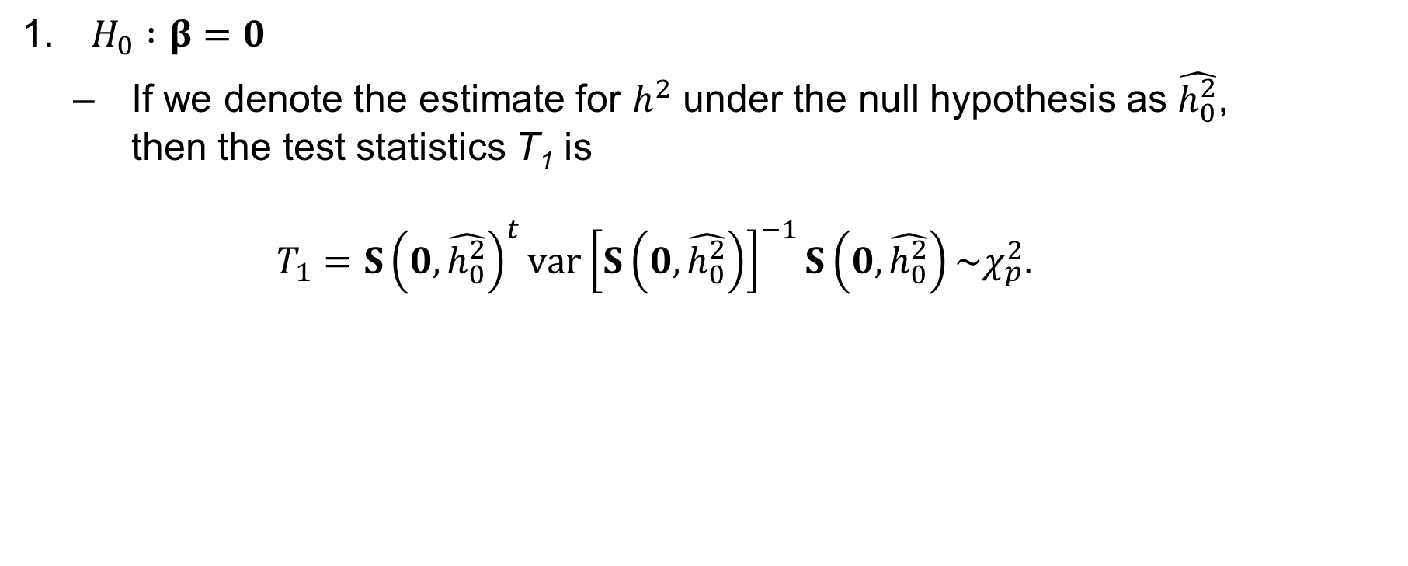
Conditional Expected Score Test (CEST)
4. Heritability Estimation and Genetic Association Study on the Binary Trait
Notations and the disease model
Estimation of the parameters using the EM algorithm
Conditional expected score test
$H_{0} :β=0$
If we denote the estimate for $h^{2}$ under the null hypothesis as $\hat{h_{0}^{2}}$, then the test statistics T₁ is $T_{1}=S{\left(0,\hat{h_{0}^{2}}\right)}^{t}var{\left[S\left(0,\hat{h_{0}^{2}}\right)\right]}^{−1}S\left(0,\hat{h_{0}^{2}}\right)\sim χ_{p}^{2}.$

Slide 63
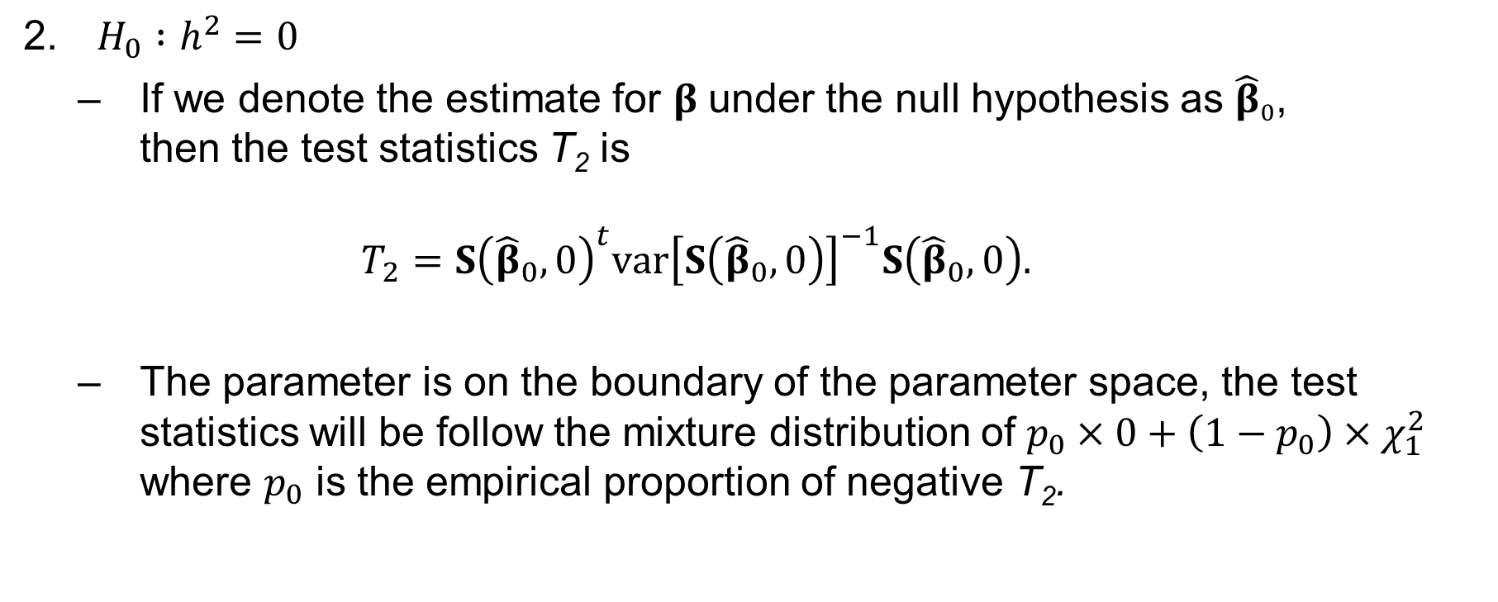
Conditional Expected Score Test (CEST)
4. Heritability Estimation and Genetic Association Study on the Binary Trait
Notations and the disease model
Estimation of the parameters using the EM algorithm
Conditional expected score test
$H_{0} :h^{2}=0$
If we denote the estimate for $β$ under the null hypothesis as ${\hat{β}}_{0}$, then the test statistics T₂ is $T_{2}=S{\left({\hat{β}}_{0},0\right)}^{t}var{\left[S\left({\hat{β}}_{0},0\right)\right]}^{−1}S\left({\hat{β}}_{0},0\right).$
The parameter is on the boundary of the parameter space, the test statistics will be follow the mixture distribution of $p_{0}×0+\left(1−p_{0}\right)×χ_{1}^{2}$ where $p_{0}$ is the empirical proportion of negative T₂.

Slide 64
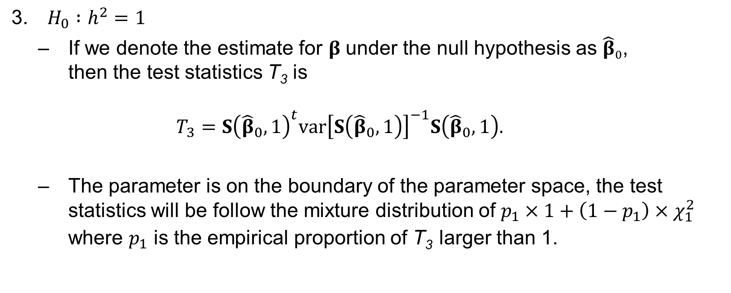
Conditional Expected Score Test (CEST)
4. Heritability Estimation and Genetic Association Study on the Binary Trait
Notations and the disease model
Estimation of the parameters using the EM algorithm
Conditional expected score test
$H_{0} :h^{2}=1$
If we denote the estimate for $β$ under the null hypothesis as ${\hat{β}}_{0}$, then the test statistics T₃ is $T_{3}=S{\left({\hat{β}}_{0},1\right)}^{t}var{\left[S\left({\hat{β}}_{0},1\right)\right]}^{−1}S\left({\hat{β}}_{0},1\right).$
The parameter is on the boundary of the parameter space, the test statistics will be follow the mixture distribution of $p_{1}×1+\left(1−p_{1}\right)×χ_{1}^{2}$ where $p_{1}$ is the empirical proportion of T₃ larger than 1.

Slide 65
Simulation Settings
4. Heritability Estimation and Genetic Association Study on the Binary Trait
Simulation study
Application to GWAS of LAM
Application to heritability estimation of CRC
10,000 families with three, four, five and six members consisting of a parents and offsprings at the rates of 0.2, 0.3, 0.3 and 0.2 respectively.
One causal SNP with MAF of 0.2 & h_{a}² : 0.005
No environmental effect
h² : 0.2 and 0.4 & q : 0.1 and 0.2
300 replicates with randomly selected 500 families among 10,000 families

Slide 66
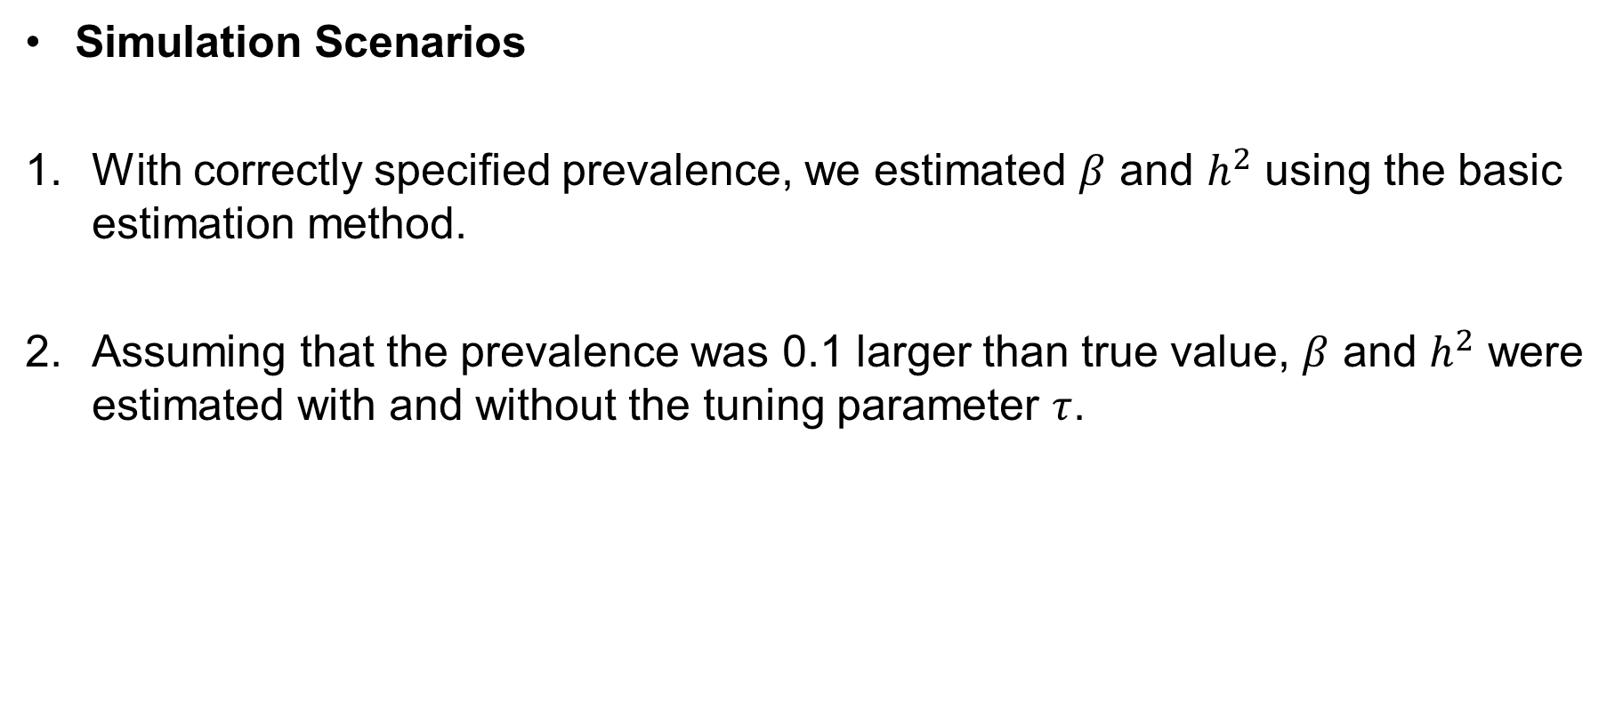
Simulation Settings
4. Heritability Estimation and Genetic Association Study on the Binary Trait
Simulation study
Application to GWAS of LAM
Application to heritability estimation of CRC
Simulation Scenarios
With correctly specified prevalence, we estimated $β$ and $h^{2}$ using the basic estimation method.
Assuming that the prevalence was 0.1 larger than true value, $β$ and $h^{2}$ were estimated with and without the tuning parameter $τ$.

Slide 67
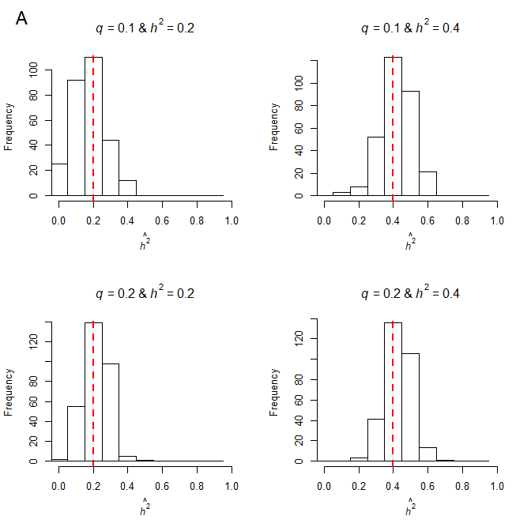
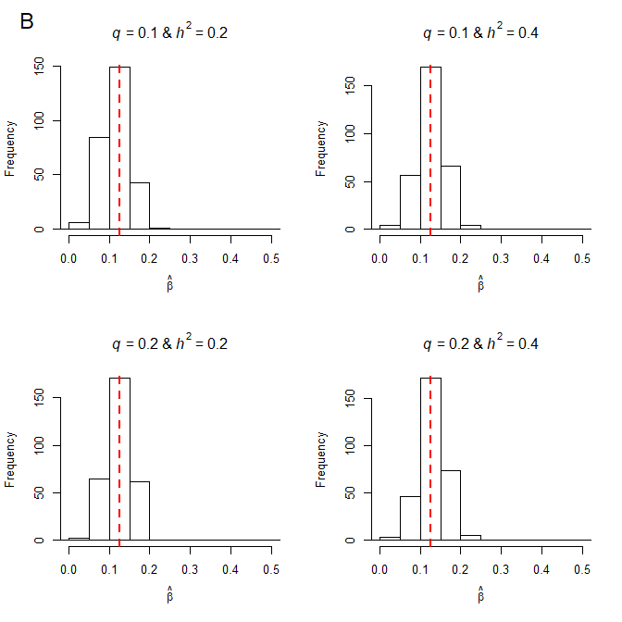
Simulation Results
4. Heritability Estimation and Genetic Association Study on the Binary Trait
Simulation study
Application to GWAS of LAM
Application to heritability estimation of CRC
With correctly specified prevalence

Slide 68


Simulation Results
4. Heritability Estimation and Genetic Association Study on the Binary Trait
Simulation study
Application to GWAS of LAM
Application to heritability estimation of CRC
With misspecified prevalences

Slide 69


Simulation Results
4. Heritability Estimation and Genetic Association Study on the Binary Trait
Simulation study
Application to GWAS of LAM
Application to heritability estimation of CRC
With misspecified prevalences, including tuning parameter

Slide 70

Simulation Results
4. Heritability Estimation and Genetic Association Study on the Binary Trait
Simulation study
Application to GWAS of LAM
Application to heritability estimation of CRC
With misspecified prevalences, including tuning parameter

Slide 71
Application to GWAS of LAM
4. Heritability Estimation and Genetic Association Study on the Binary Trait
Simulation study
Application to GWAS of LAM
Application to heritability estimation of CRC
Lymphangioleiomyomatosis (LAM) occurs in two settings:
in the disease tuberous sclerosis complex (TSC-LAM)
TSC-LAM occurs in women who have germline mutations in either the TSC1 or the TSC2 gene.
The TSC1 gene is located on chromosome 9q34
The TSC2 gene is located on chromosome 16p13.
in a sporadic form, in women who do not have TSC (sporadic LAM).
Prevalence of sporadic LAM is 1 per 2.5x10⁵

Slide 72
Application to GWAS of LAM
4. Heritability Estimation and Genetic Association Study on the Binary Trait
Simulation study
Application to GWAS of LAM
Application to heritability estimation of CRC
Hypothesis
DNA sequence variants outside of TSC2/TSC1 may be associated with susceptibility/risk for LAM disease development
Genome-wide association studies (GWAS) of sporadic LAM (S-LAM) are used to identify such genetic variants

Slide 73

Application to GWAS of LAM
4. Heritability Estimation and Genetic Association Study on the Binary Trait
Simulation study
Application to GWAS of LAM
Application to heritability estimation of CRC
Data description and Quality control for discovery data

Slide 74
Application to GWAS of LAM
4. Heritability Estimation and Genetic Association Study on the Binary Trait
Simulation study
Application to GWAS of LAM
Application to heritability estimation of CRC
Study design
Logistic regression (LR)
Age, squared age and ten PC scores were included as covariates
Conditional logistic regression (CLR)
1:2 matched case-control design
Matching was based on age and top three PC scores

Slide 75

Application to GWAS of LAM
4. Heritability Estimation and Genetic Association Study on the Binary Trait
Simulation study
Application to GWAS of LAM
Application to heritability estimation of CRC
Results
chr | SNP | Nt | Minor/ major alleles | MAF (Top: S-LAM, Bottom: control) | Genotype Counts (Top: S-LAM, Bottom: control) |  |  | Discovery data |  |  |  | Replication data
 |  |  |  |  |  |  |  | OR (LR) |  | P-value |  | OR | P-value
 |  |  |  |  | AA | AG | GG | Original | Bias adjusted | LR | CLR
15 | rs4544201 | 96167827 | A/G | 0.1659 | 16 | 109 | 300 | 0.5674 | 0.5898 | 3.09$×$10⁻⁷ | 4.82$×$10⁻⁹ | 0.4951 | 4.39×10⁻⁵
 |  |  |  | 0.2742 | 88 | 514 | 656
15 | rs2006950 | 96179390 | A/G | 0.1425 | 11 | 100 | 315 | 0.5109 | 0.5227 | 7.78$×$10⁻⁹ | 6.53$×$10⁻¹⁰ | 0.4161 | 3.91$×$10⁻⁶
 |  |  |  | 0.2546 | 84 | 474 | 703

Slide 76


Application to GWAS of LAM
4. Heritability Estimation and Genetic Association Study on the Binary Trait
Simulation study
Application to GWAS of LAM
Application to heritability estimation of CRC
Results

Slide 77
Application to heritability estimation of CRC
4. Heritability Estimation and Genetic Association Study on the Binary Trait
Simulation study
Application to GWAS of LAM
Application to heritability estimation of CRC
Data description
The cross-sectional study of a prospective cohort database
Patients taken surgery for colorectal cancer (CRC) from 2003 to 2006 were collected from Seoul National University Hospital (SNUH) and Seoul National University Bundang Hospital (SNUBH)
Characteristic | 1,952 probands
Gender
Male | 1,153 (59.1 %)
Female | 799 (40.9 %)
Age at onset
Mean, Median (interquartile rage) | 61.7, 63 (55 - 70)
50 > | 229 (11.7 %)
50 ≤ | 1,723 (88.3 %)

Slide 78
Application to heritability estimation of CRC
4. Heritability Estimation and Genetic Association Study on the Binary Trait
Simulation study
Application to GWAS of LAM
Application to heritability estimation of CRC
Statistical Analysis
Family history (FH) of CRC for each proband was defined using first-degree of relatives (FDR) in two ways 1) the number of affected FDRs 2) the proportion of affected FDRs to all FDRs
Cox proportional hazards models were used to compute hazard ratio (HR) for CRC with FH.
HRs were adjusted using sex.

Slide 79
Application to heritability estimation of CRC
4. Heritability Estimation and Genetic Association Study on the Binary Trait
Simulation study
Application to GWAS of LAM
Application to heritability estimation of CRC
Relationship between family history of CRC and Incident CRC
Factor | No. of cases of CRC (n = 1,952) | Covariate adjusted Hazard ratio | 95% CI for Hazard ratio | P value
Family history of CRC
No | 1,766 | 1.00 (ref)
Yes | 186 | 1.1998 | (1.0306 - 1.3968) | 0.0188
No. of affected FDRs
0 (no FH) | 1,766 | 1.00 (ref)
1 FDR | 160 | 1.1240 | (1.0657 – 1.4756) | 0.0064
≥ 2 FDR | 26 | 0.9479 | (0.6433 – 1.3966) | 0.7865
Proportion of affected FDRs
[0, 0.125) | 1,843 | 1.00 (ref)
[0.125, 0.3) | 100 | 1.5949 | (1.3031 – 1.9519) | 5.933 x 10⁻⁶
[0.3,1] | 9 | 2.7498 | (1.4246 – 5.3078) | 0.0026

Slide 80
Conclusion and Discussion
4. Heritability Estimation and Genetic Association Study on the Binary Trait
Conclusion and Discussion
In this chapter, we proposed a method for estimating heritability and genetic/environmental effects on binary trait using liability threshold model
The results from the simulation studies showed that the proposed method provided robust estimators in spite of misspecification of the prevalence
However, there are many scenarios to check to evaluate the analytical flexibility such as when irrelevant covariates were included, a lot of nuclear families are included, and so on.

Slide 81
Conclusion and Discussion
4. Heritability Estimation and Genetic Association Study on the Binary Trait
Conclusion and Discussion
Further analyses
Evaluate robustness of the estimator for various situations
Compare the estimates to the existing methods
Consider the common shared correlation between family members
Evaluate statistical validity of CEST and compare existing method such as Logistic regression, MQLS, GLMM
Extend the proposed method to GWAS with the independent subjects via genetic relationship matrix

Slide 82
PLAN

Slide 83
Plan
July | August | September | October
Perform simulation studies for various scenario which can make bias of the proposed method and improve it Compare to the existing method | Implement CEST Compare the results from CEST to the existing method | Apply the proposed method to the real data (LAM, CRC) | Finish the manuscript

Slide 84
Thank you

